Slide 1
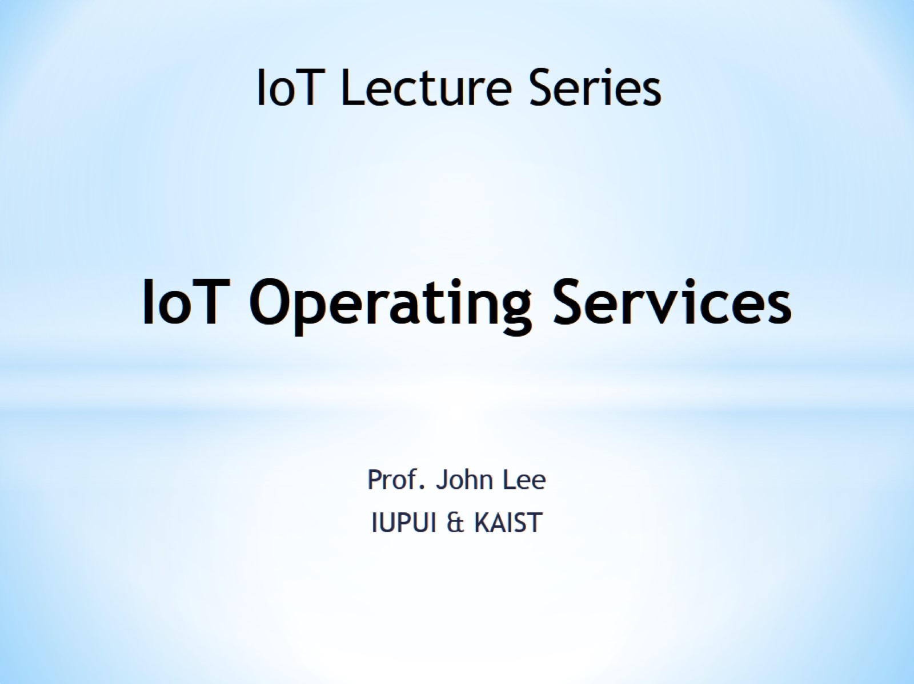
IoT Operating Services

Slide 2
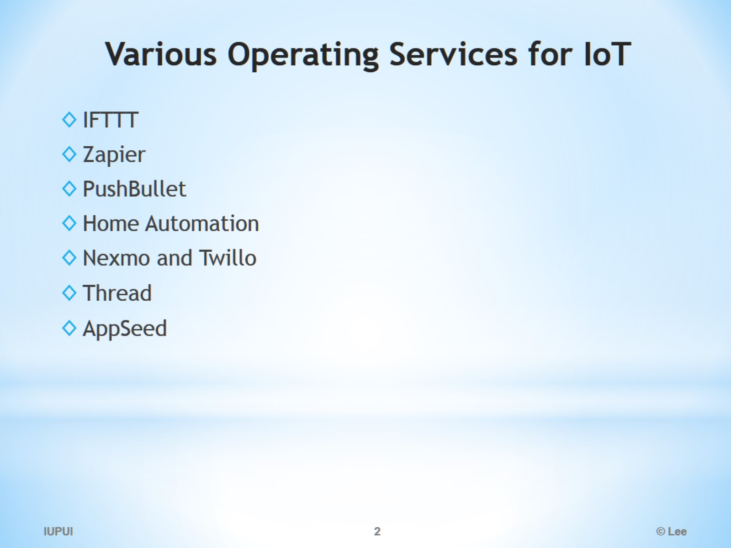
Various Operating Services for IoT

Slide 3
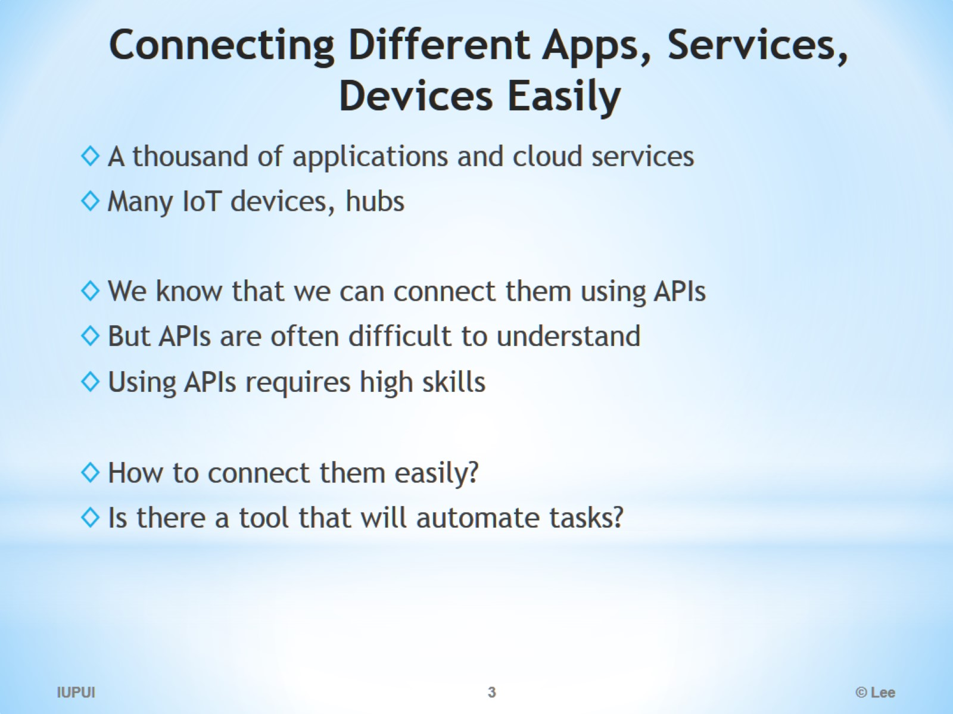
Connecting Different Apps, Services, Devices Easily

Slide 4
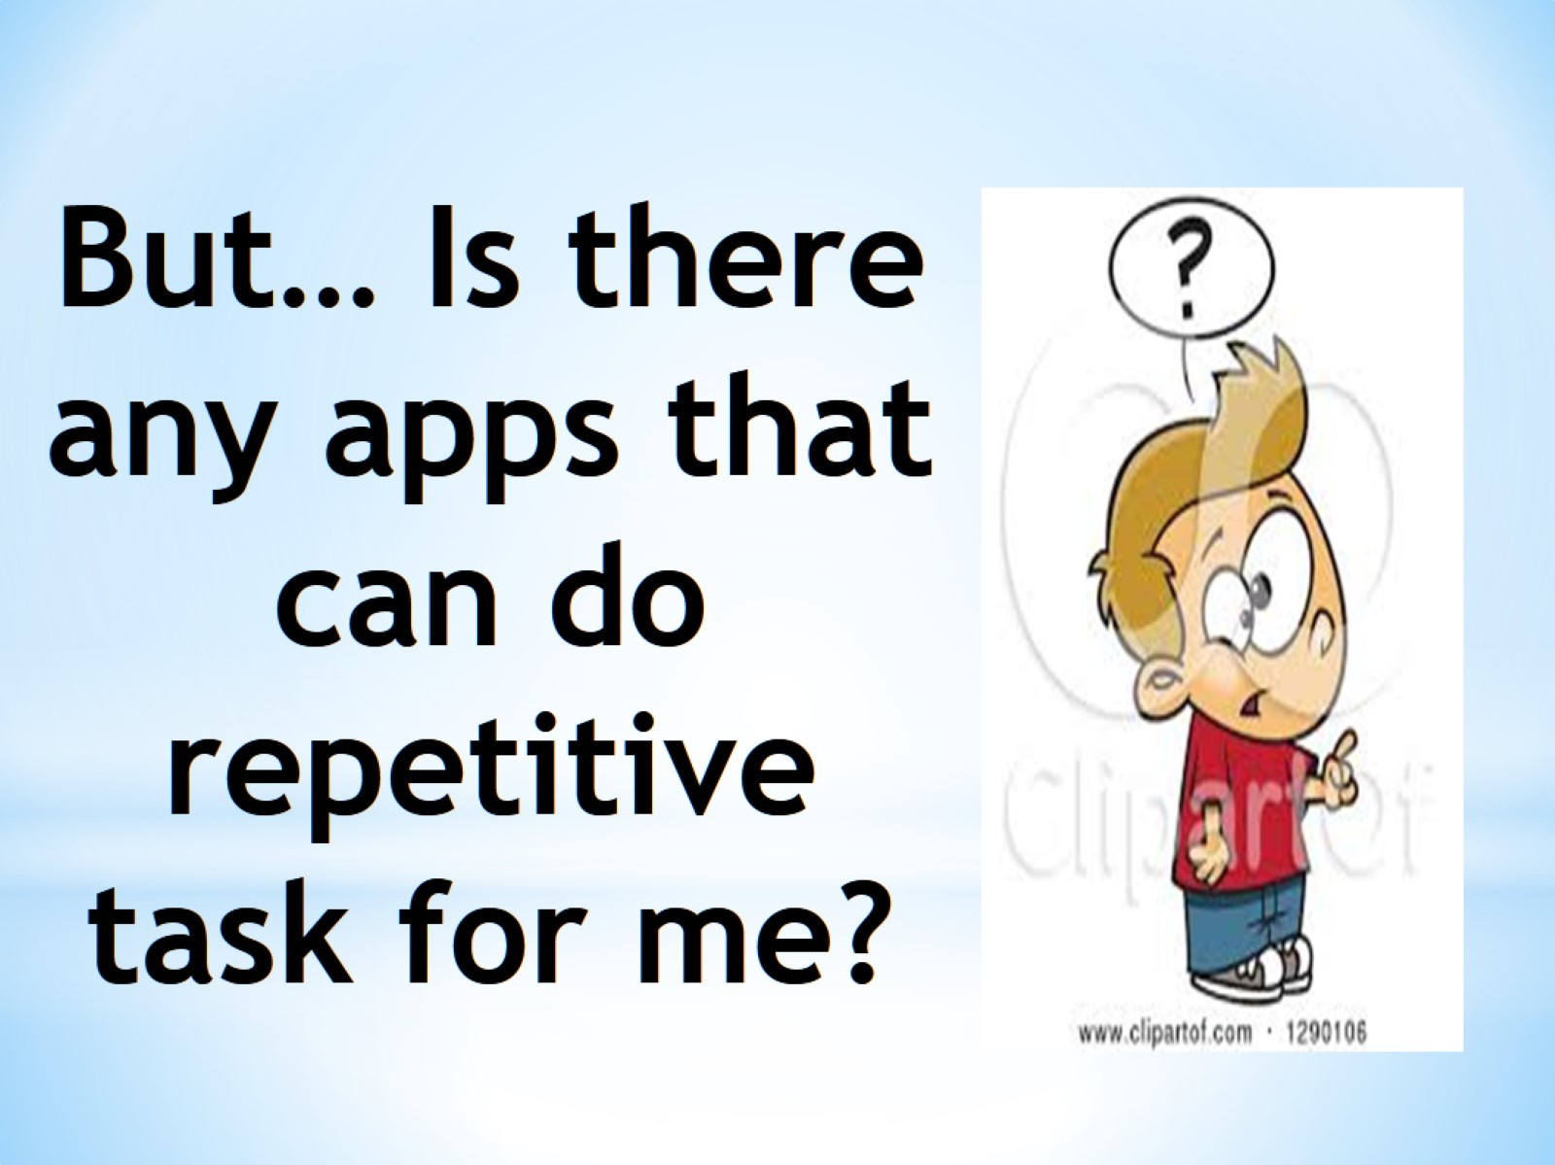
But… Is there any apps that can do repetitive task for me?

Slide 5


Slide 6


Slide 7
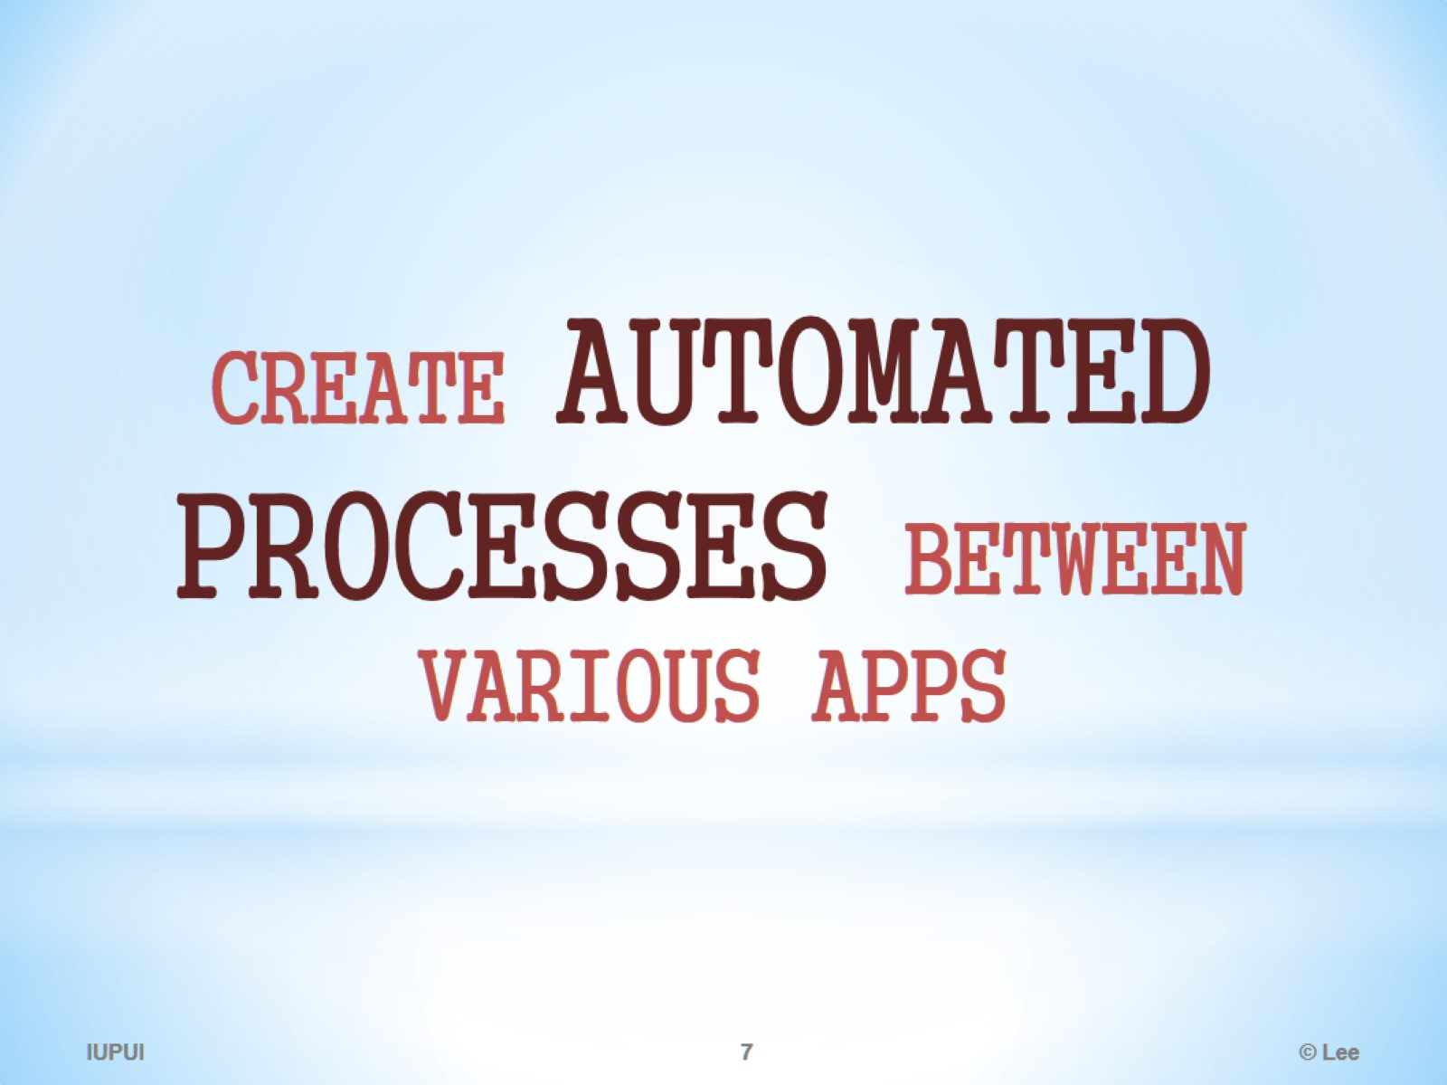

Slide 8
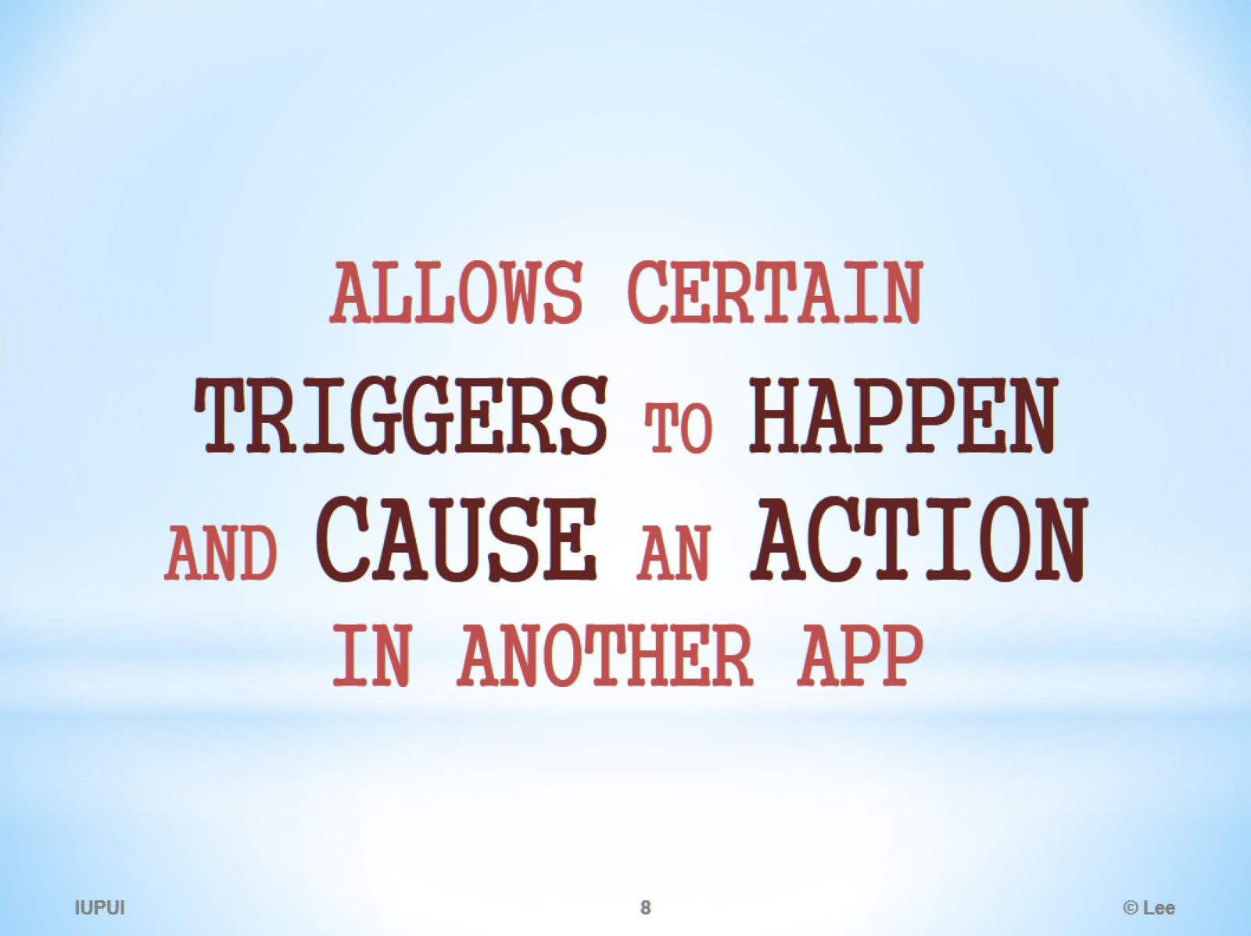

Slide 9
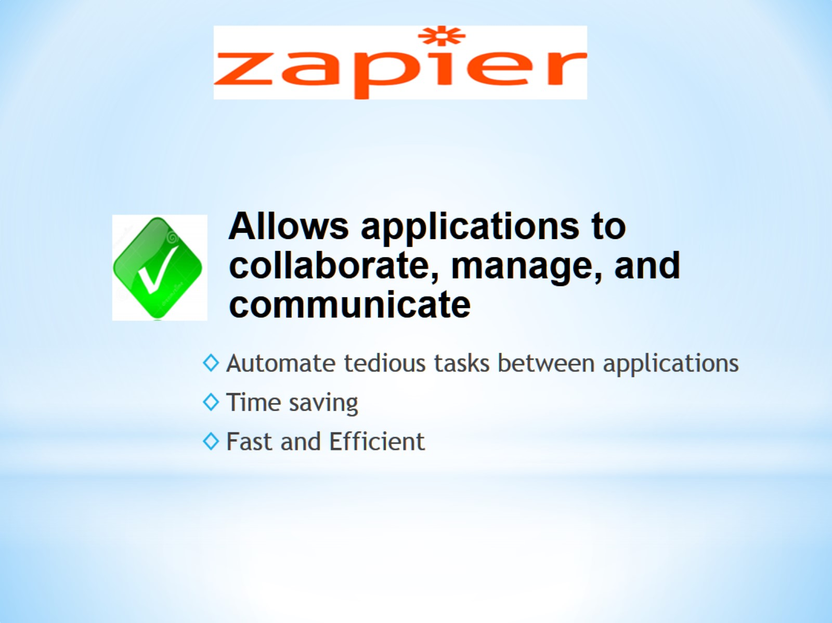

Slide 10
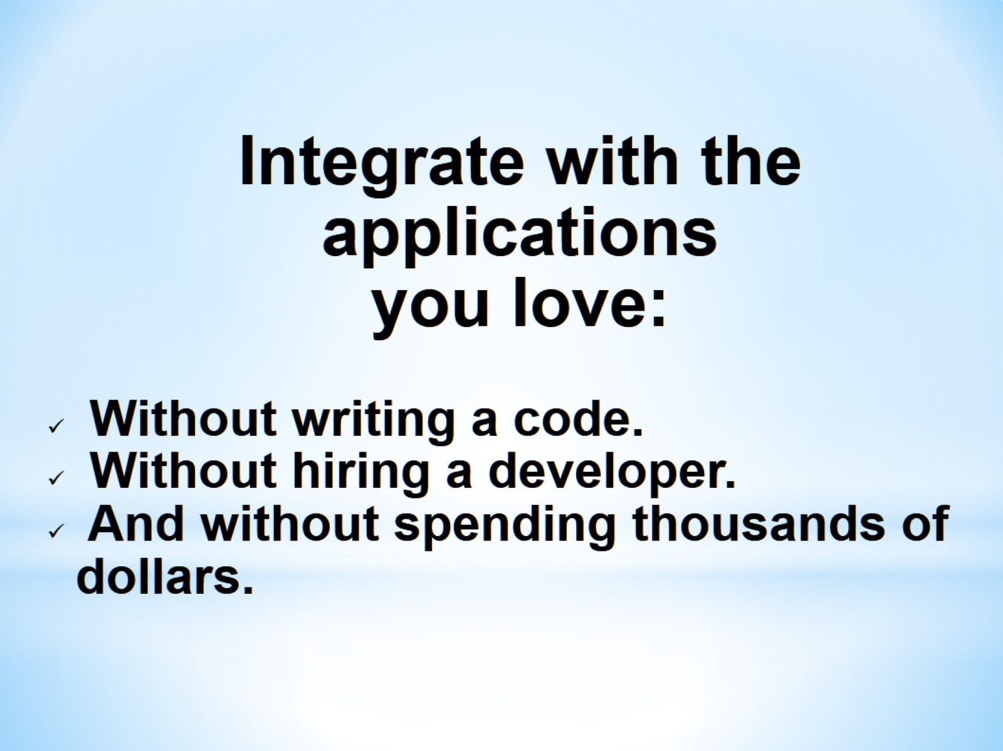

Slide 11
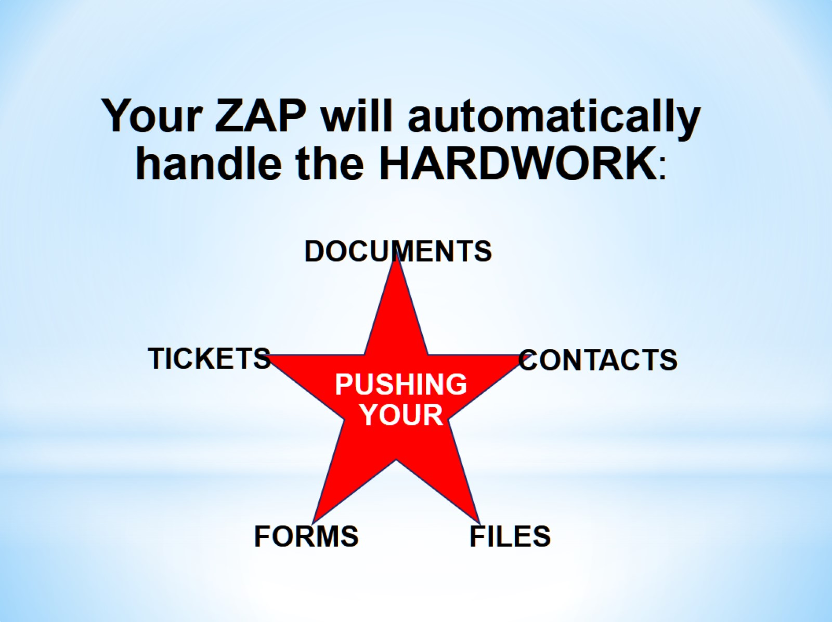

Slide 12
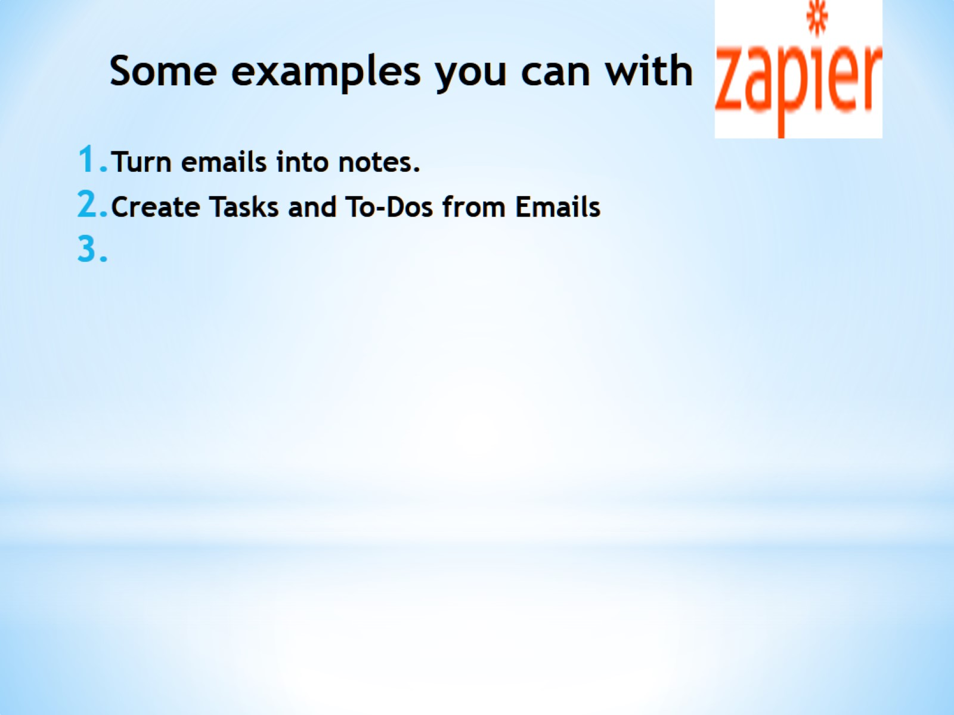
Some examples you can with

Slide 13
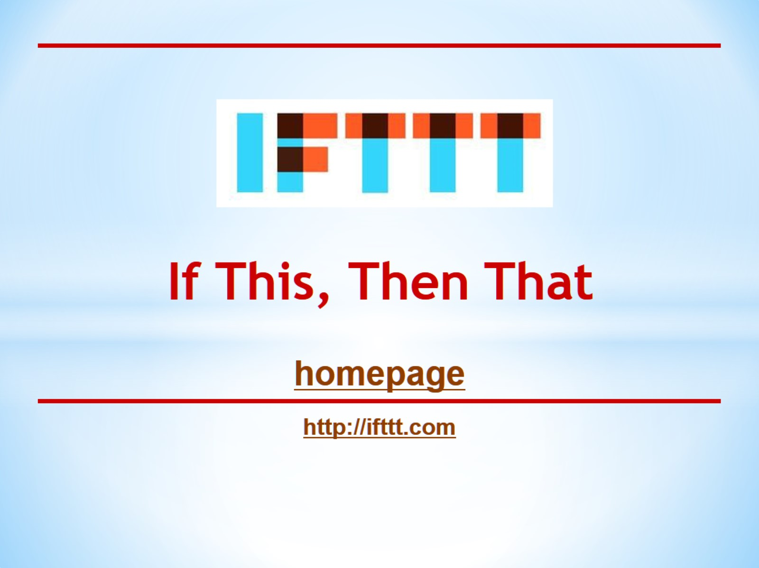
If This, Then That

Slide 14
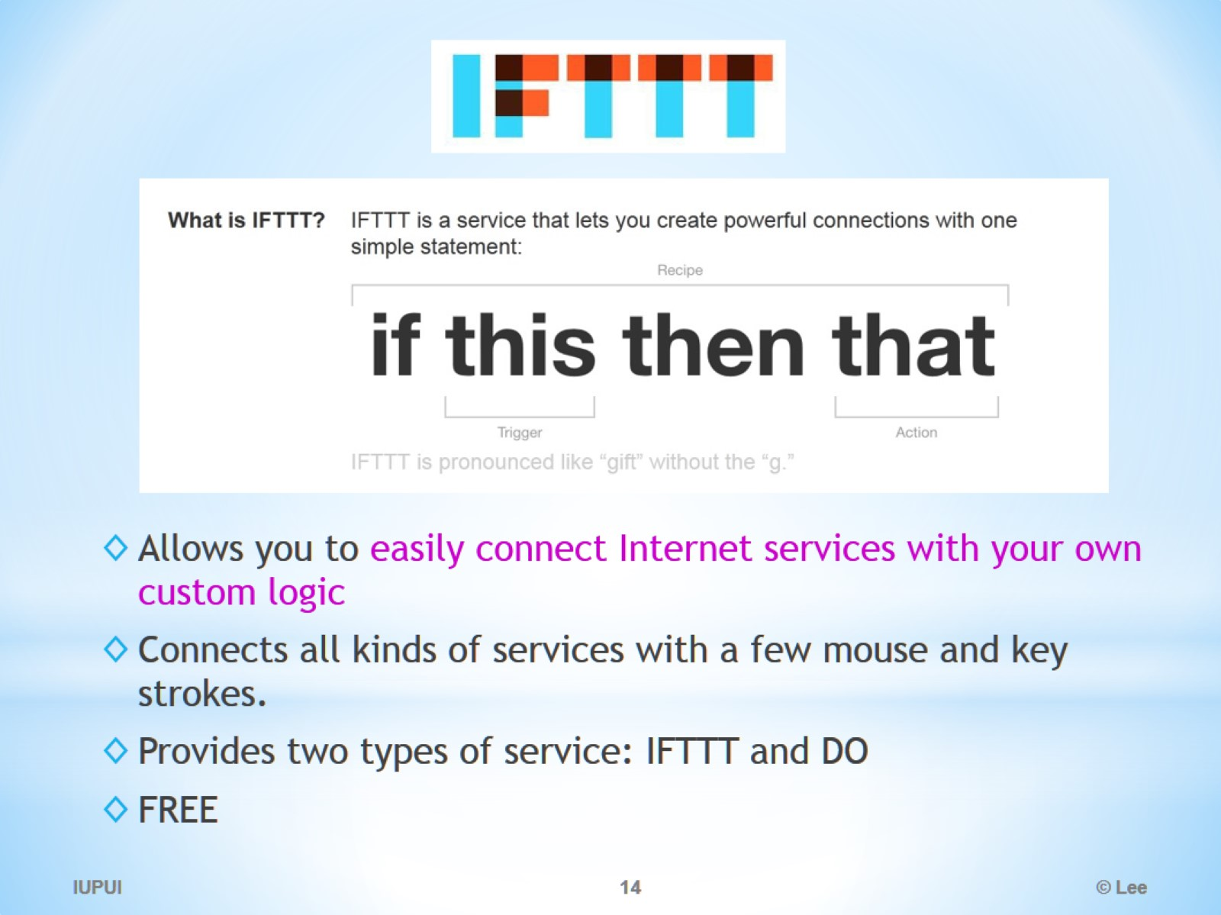
IFTTT

Slide 15
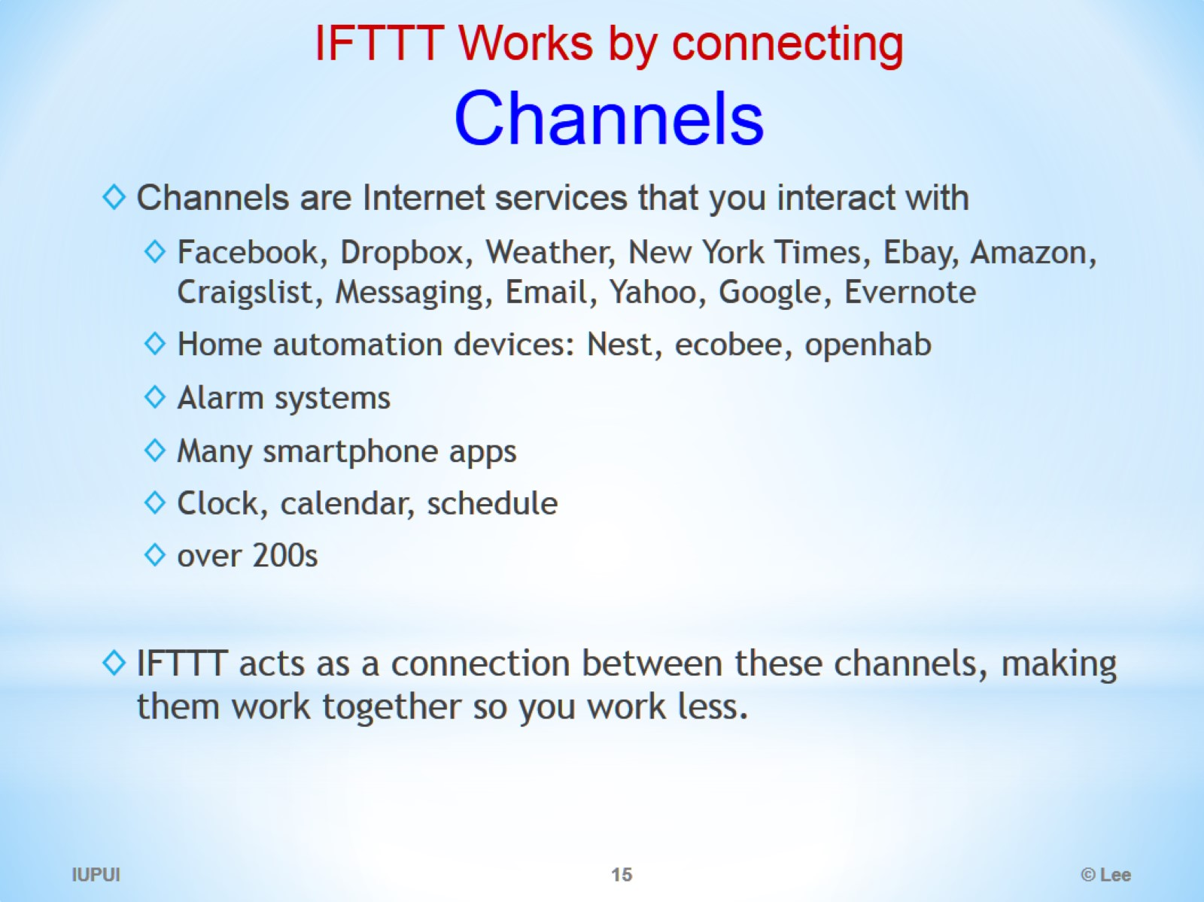
IFTTT Works by connecting Channels

Slide 16
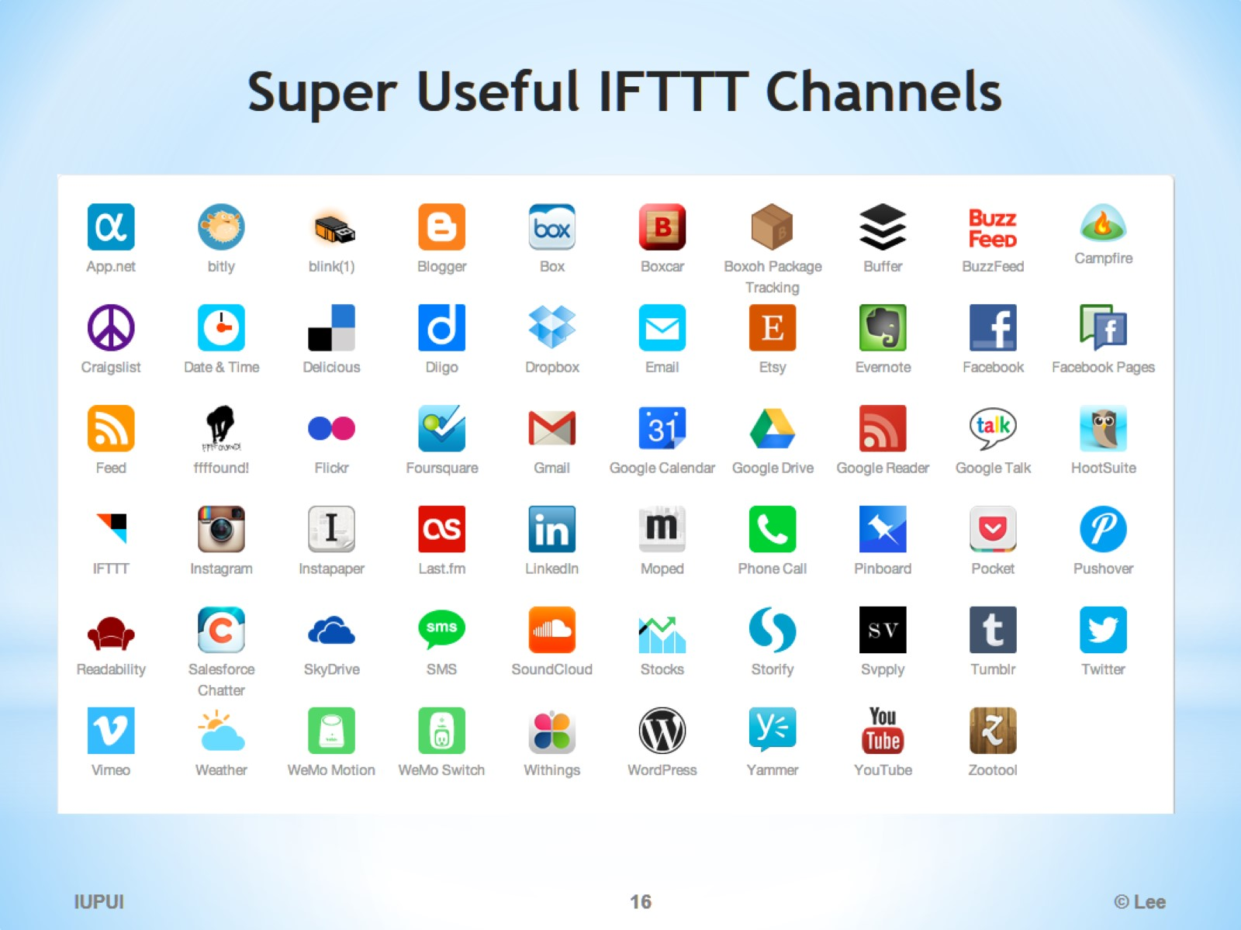
Super Useful IFTTT Channels

Slide 17
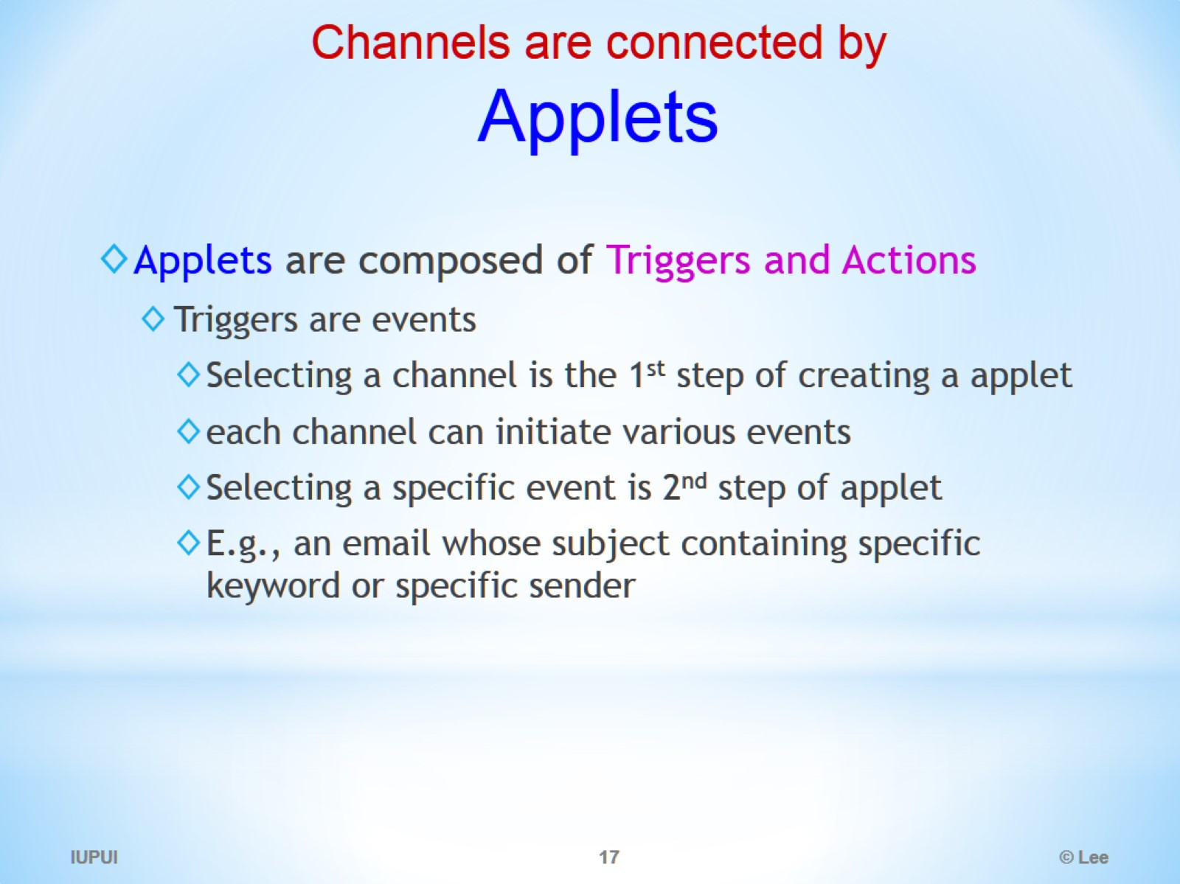
Channels are connected by Applets

Slide 18
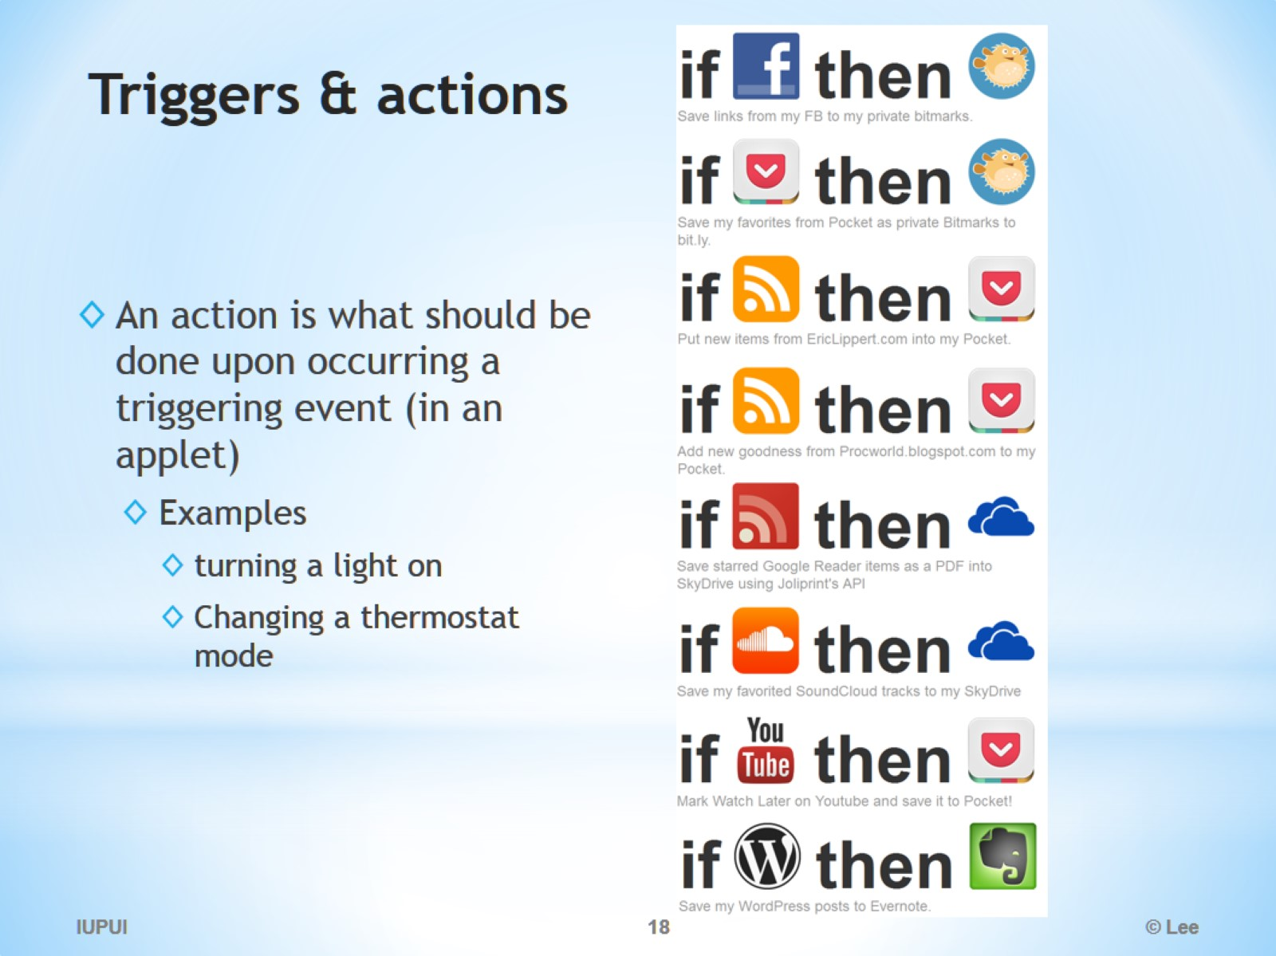
Triggers & actions

Slide 19
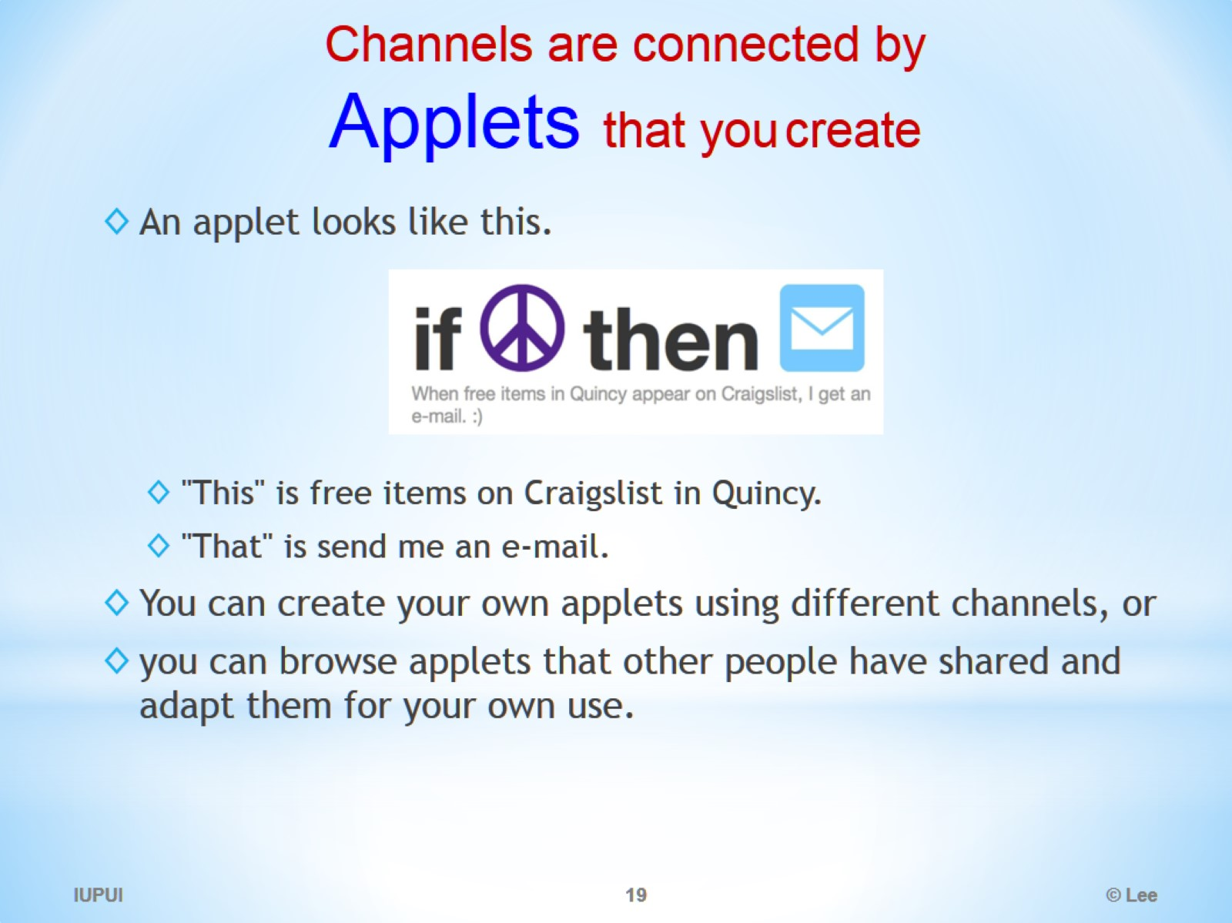
Channels are connected by Applets that you create

Slide 20
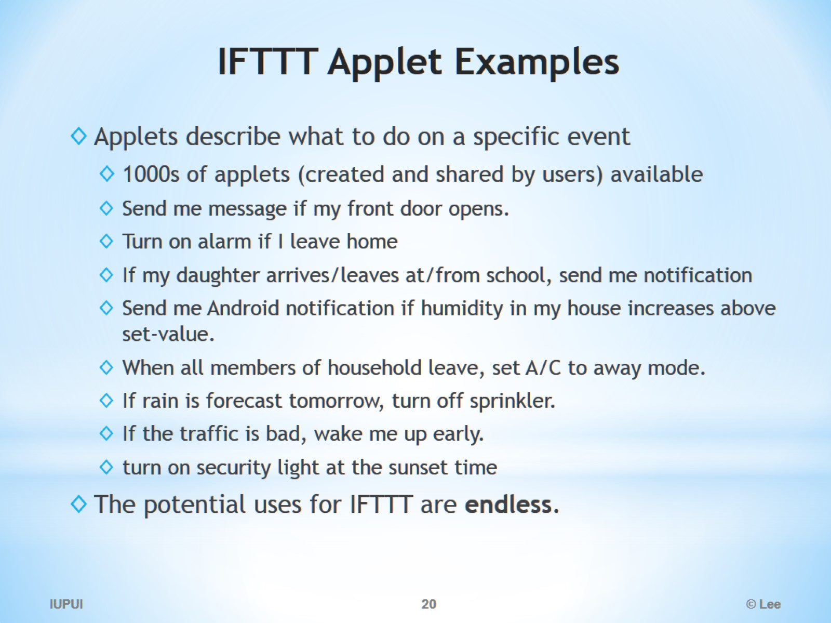
IFTTT Applet Examples

Slide 21
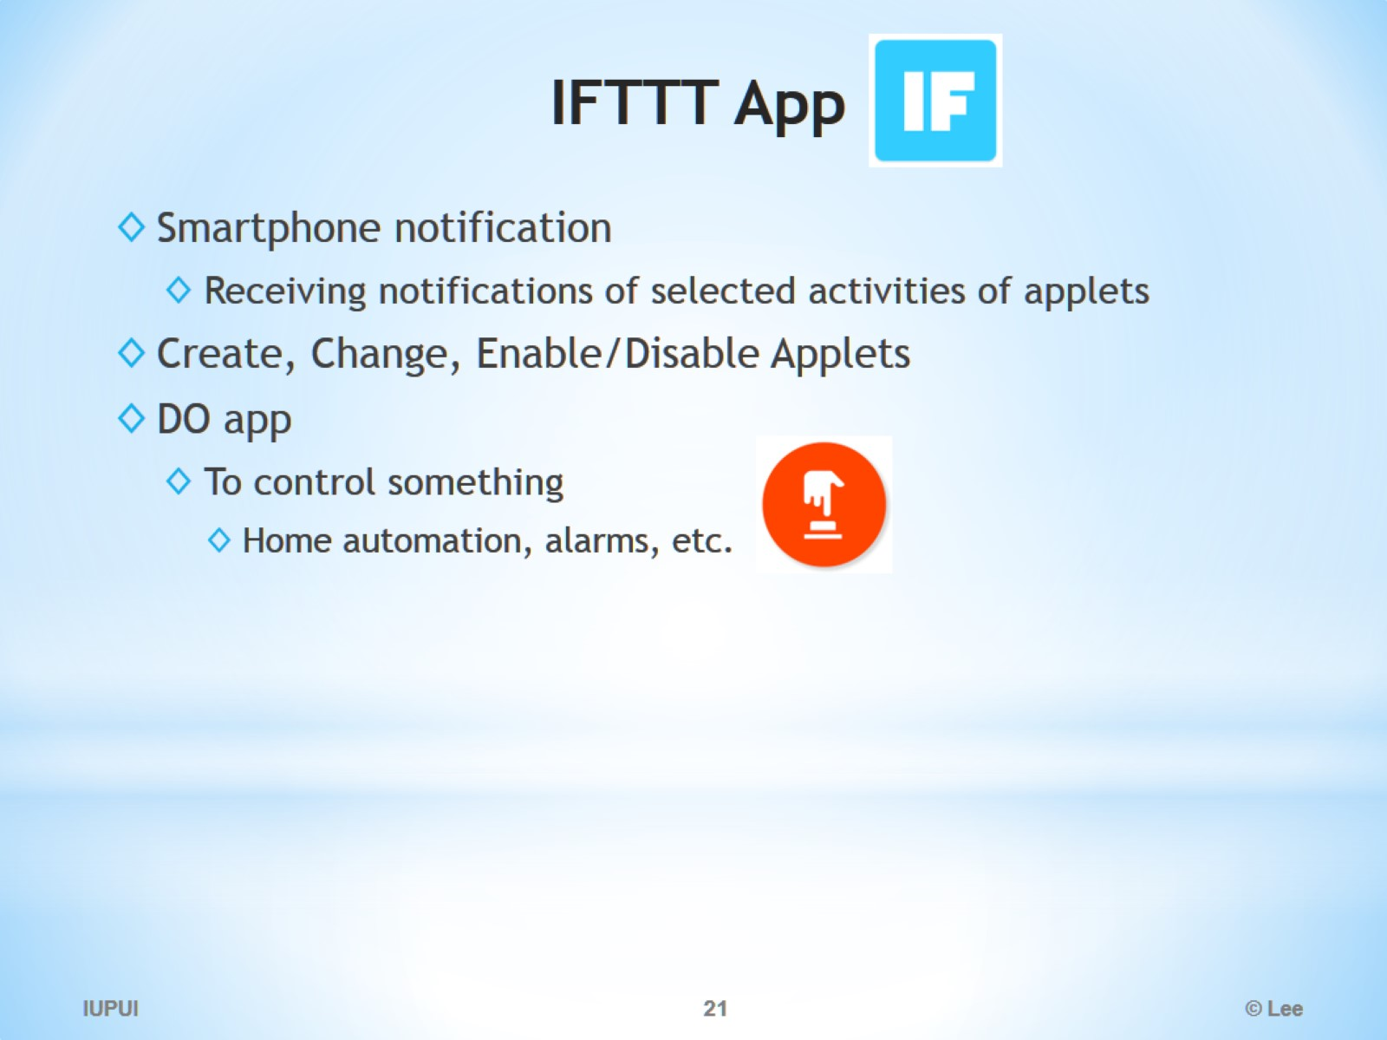
IFTTT App

Slide 22
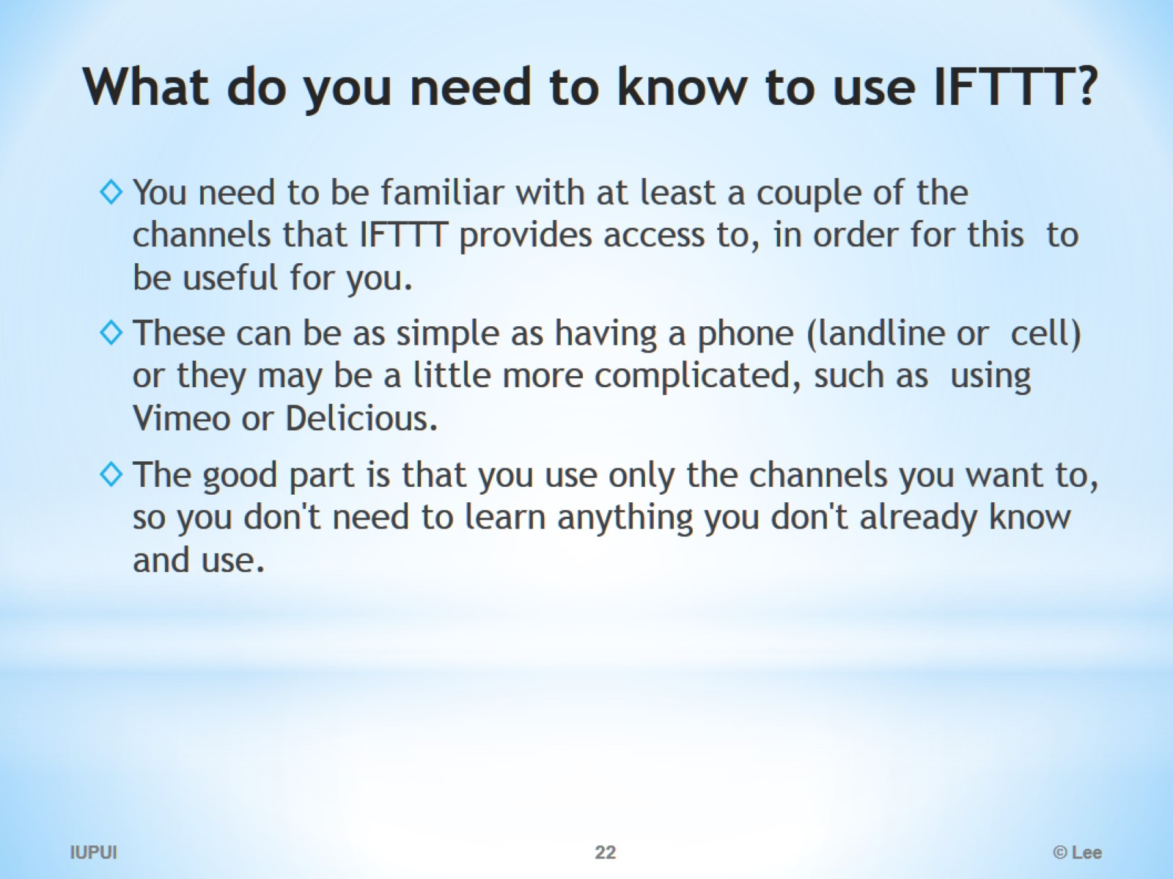
What do you need to know to use IFTTT?

Slide 23
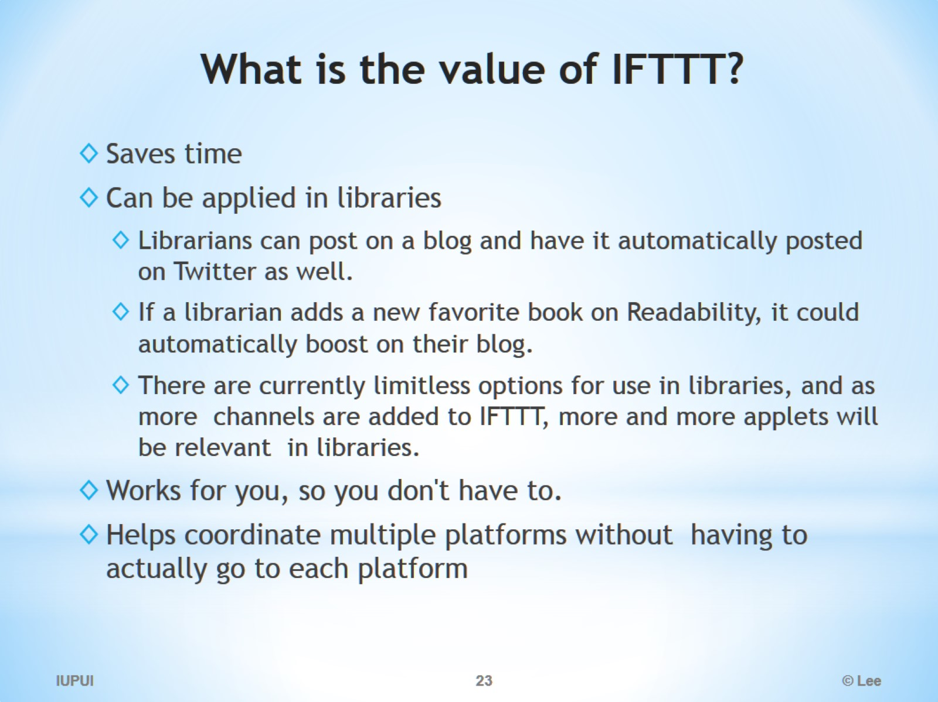
What is the value of IFTTT?

Slide 24
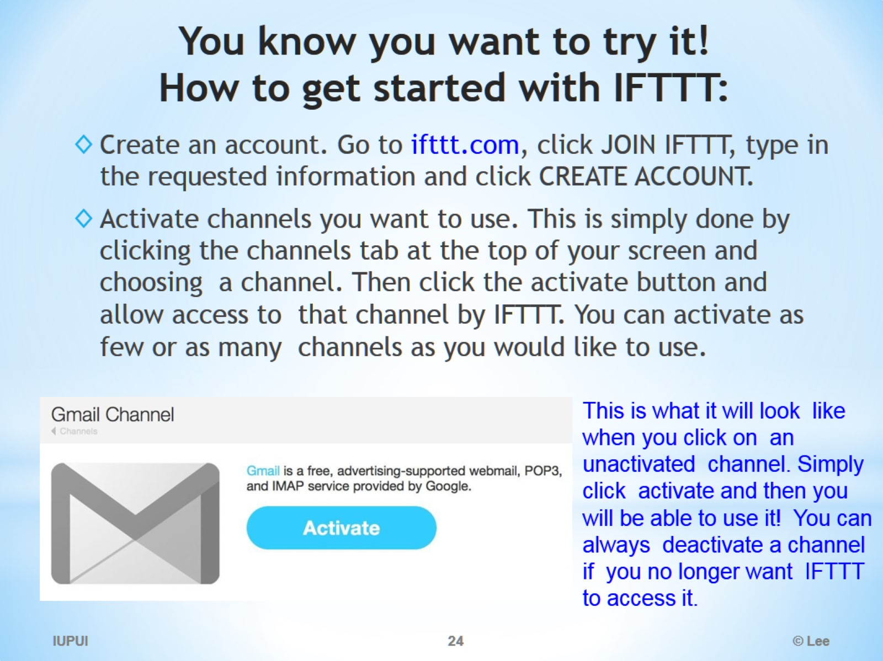
You know you want to try it! How to get started with IFTTT:

Slide 25
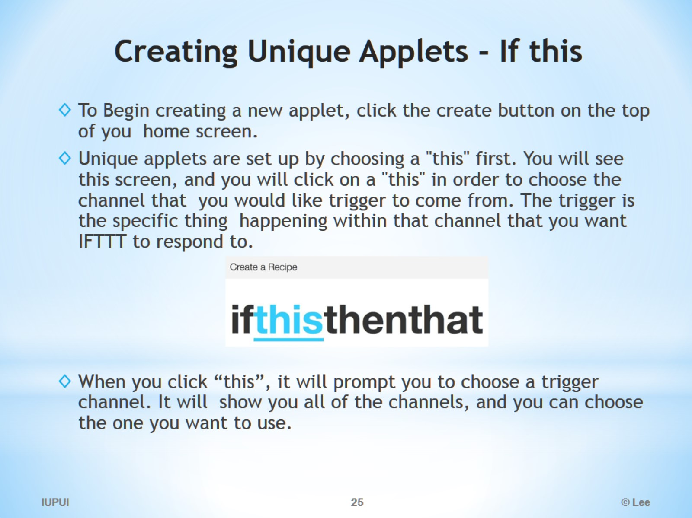
Creating Unique Applets - If this

Slide 26
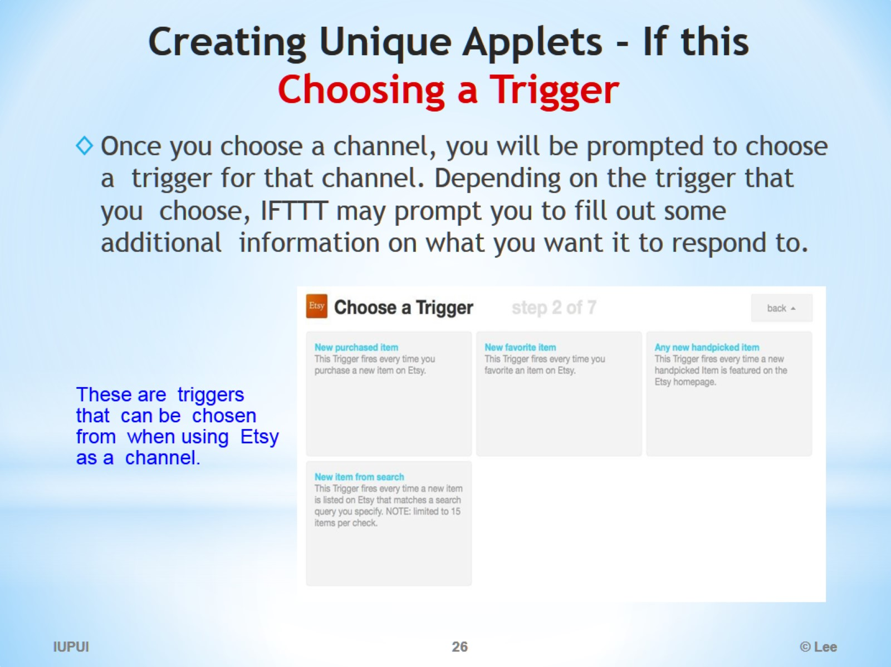
Creating Unique Applets - If this Choosing a Trigger

Slide 27
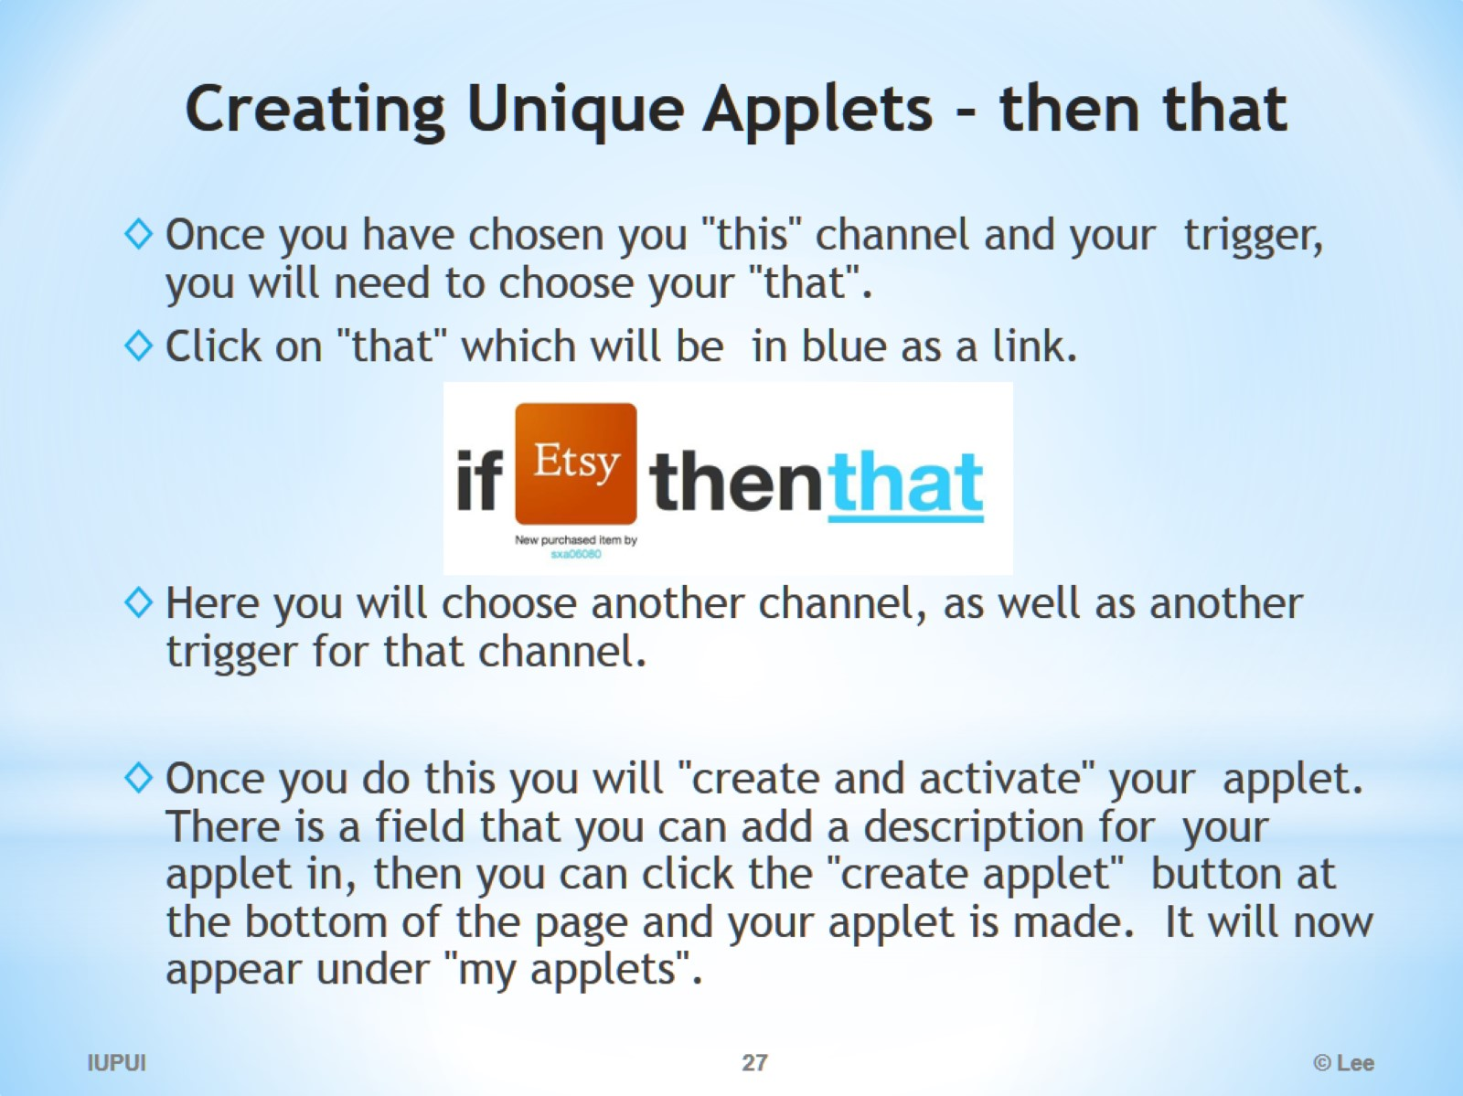
Creating Unique Applets - then that

Slide 28
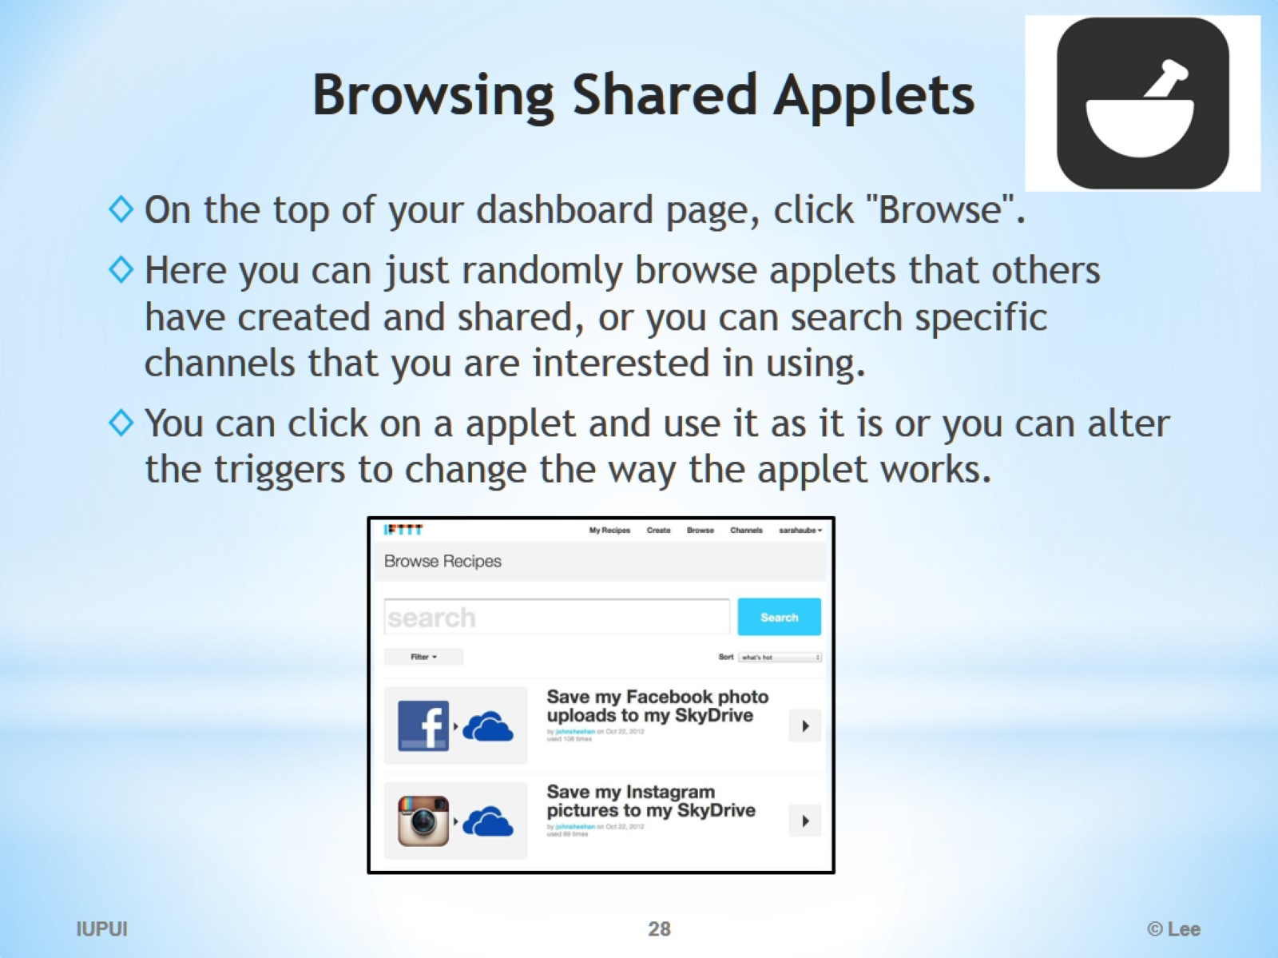
Browsing Shared Applets

Slide 29
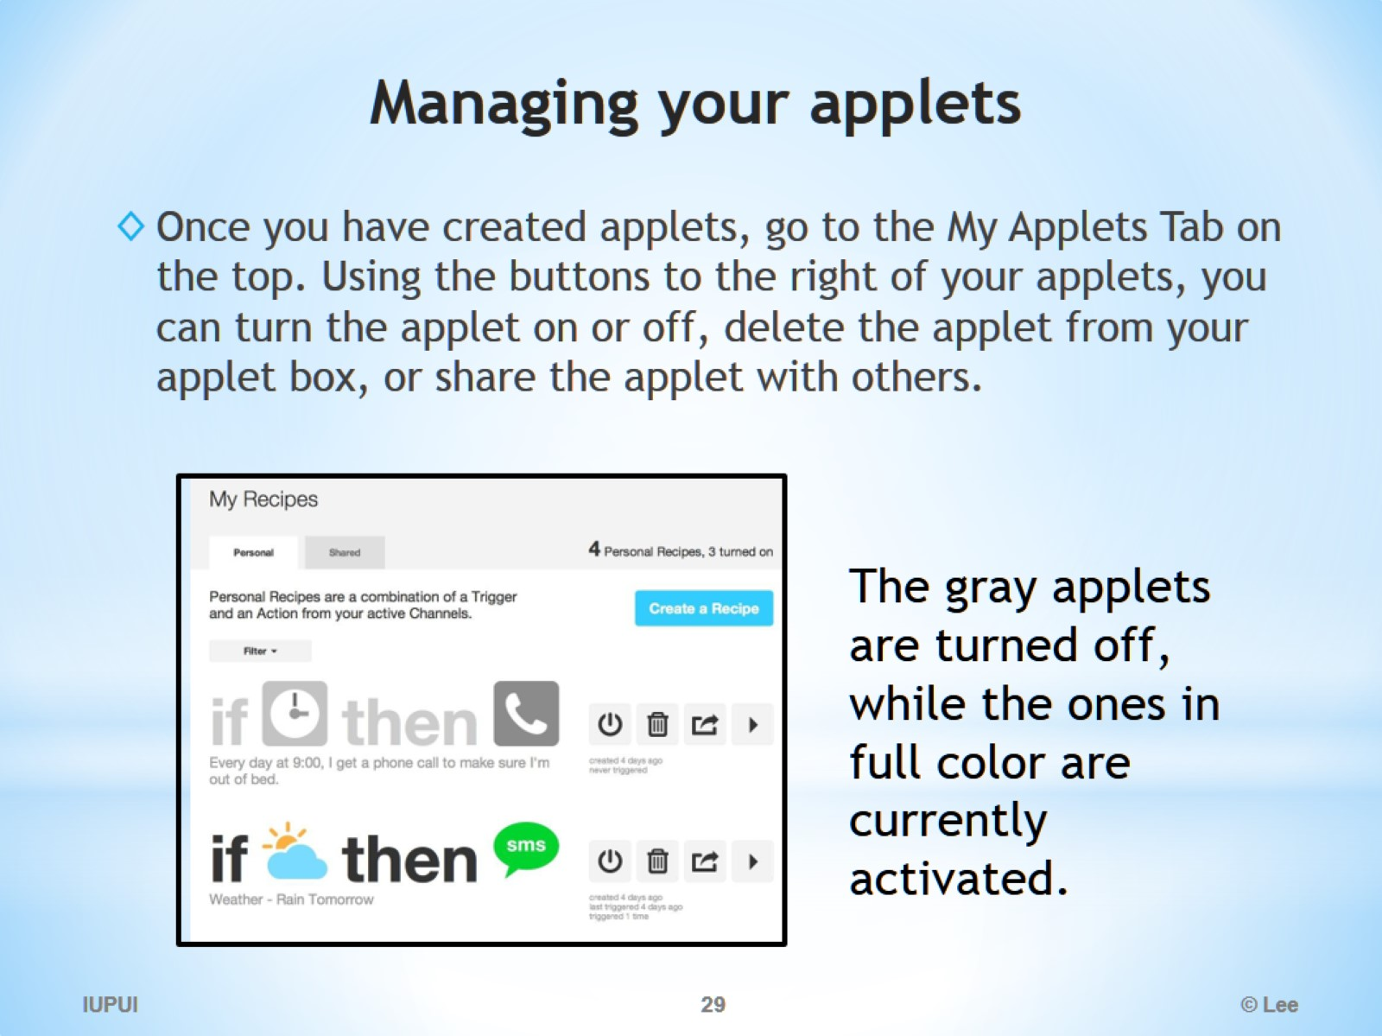
Managing your applets

Slide 30
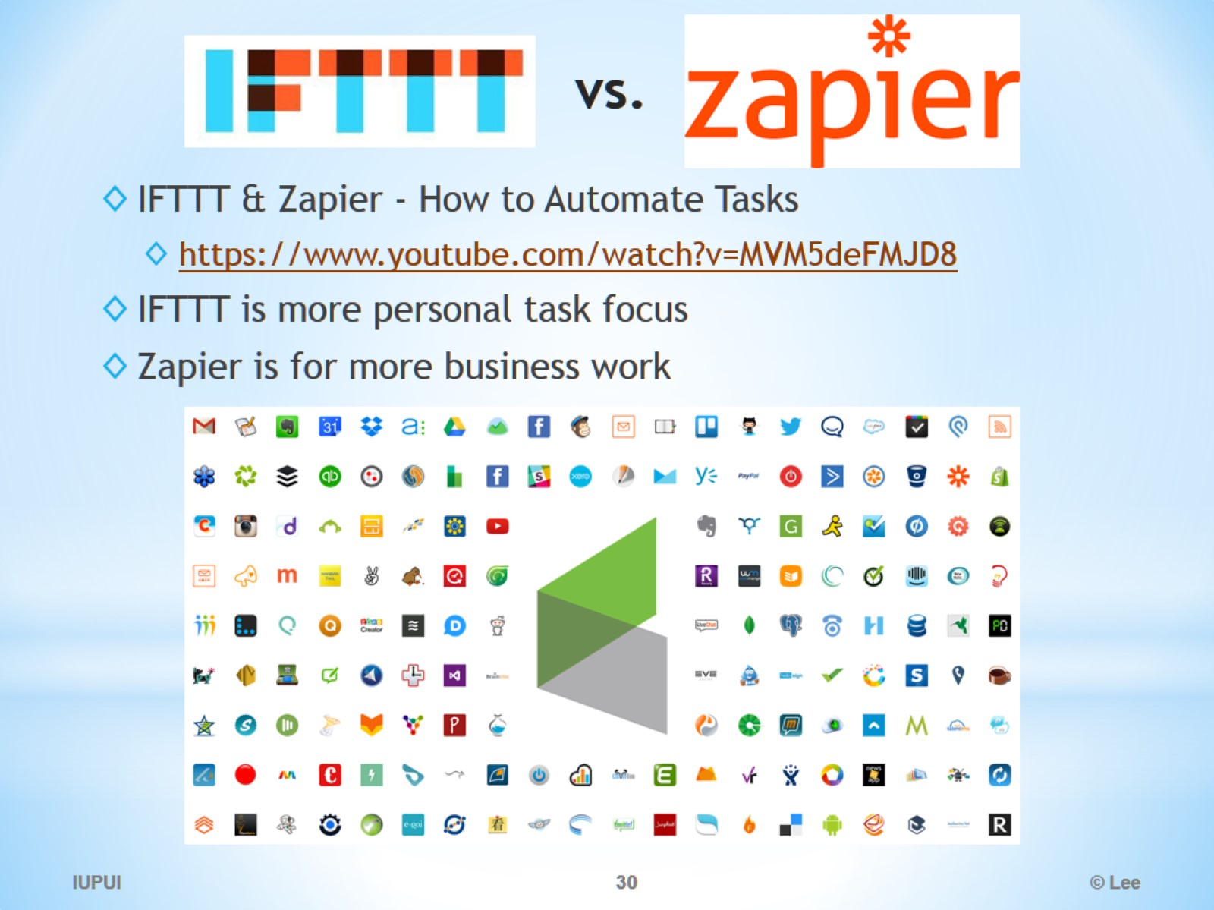
vs.

Slide 31
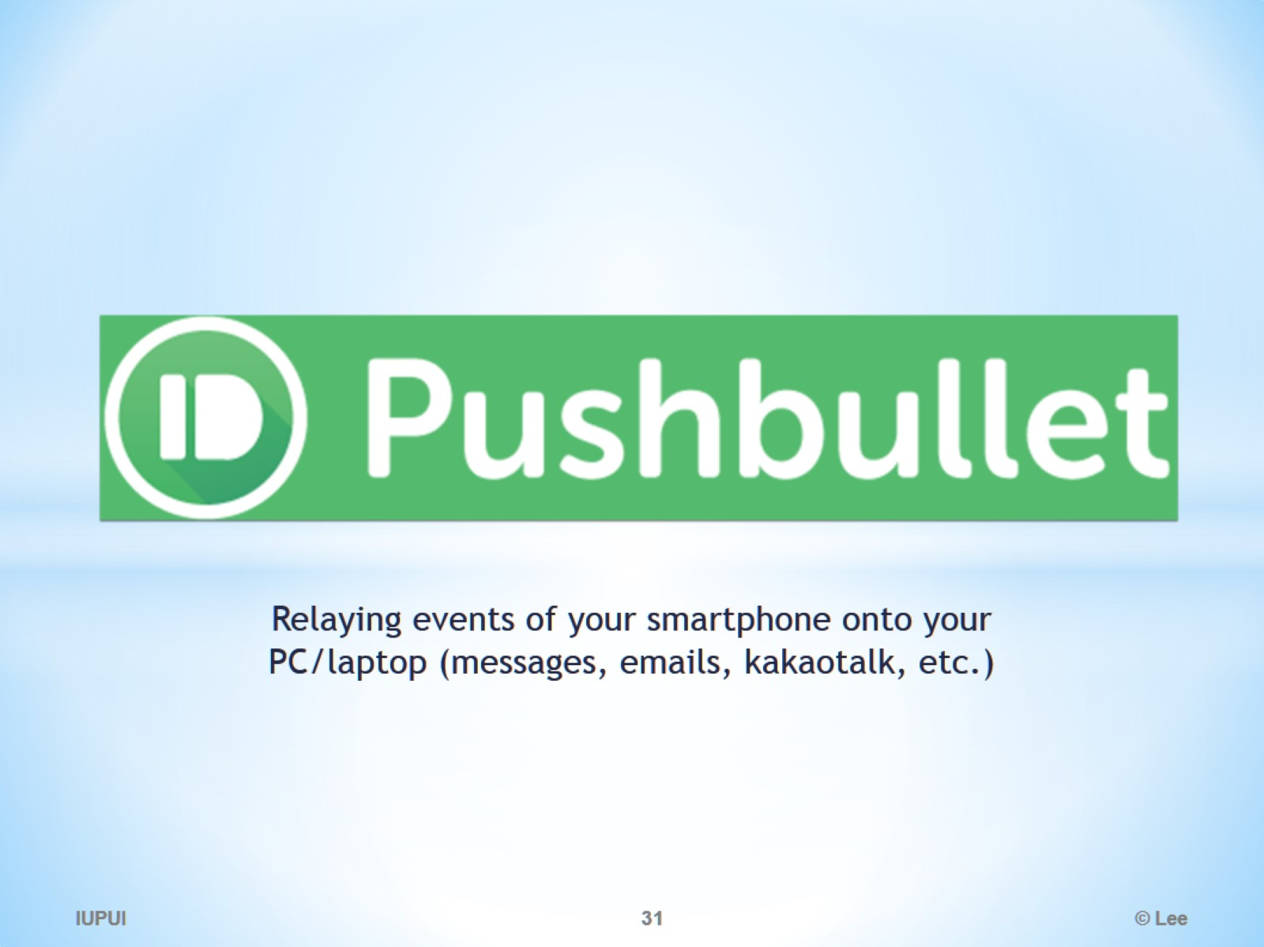

Slide 32
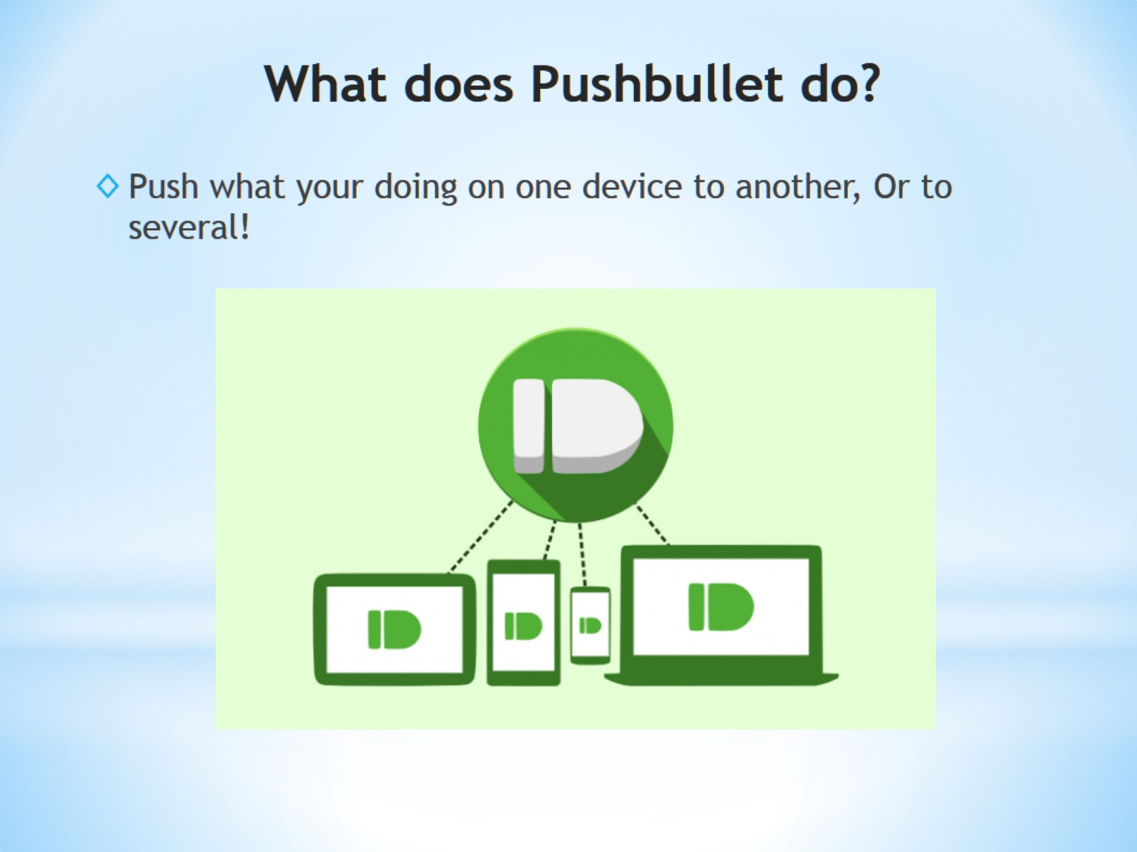
What does Pushbullet do?

Slide 33
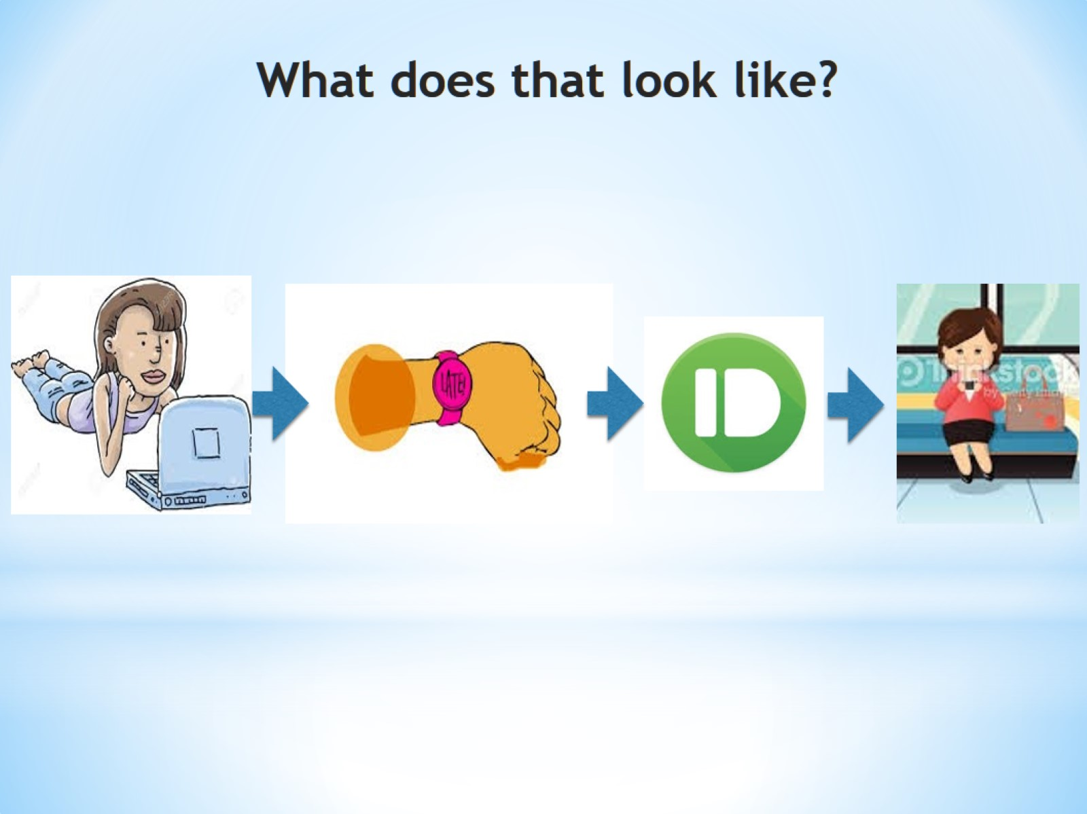
What does that look like?

Slide 34
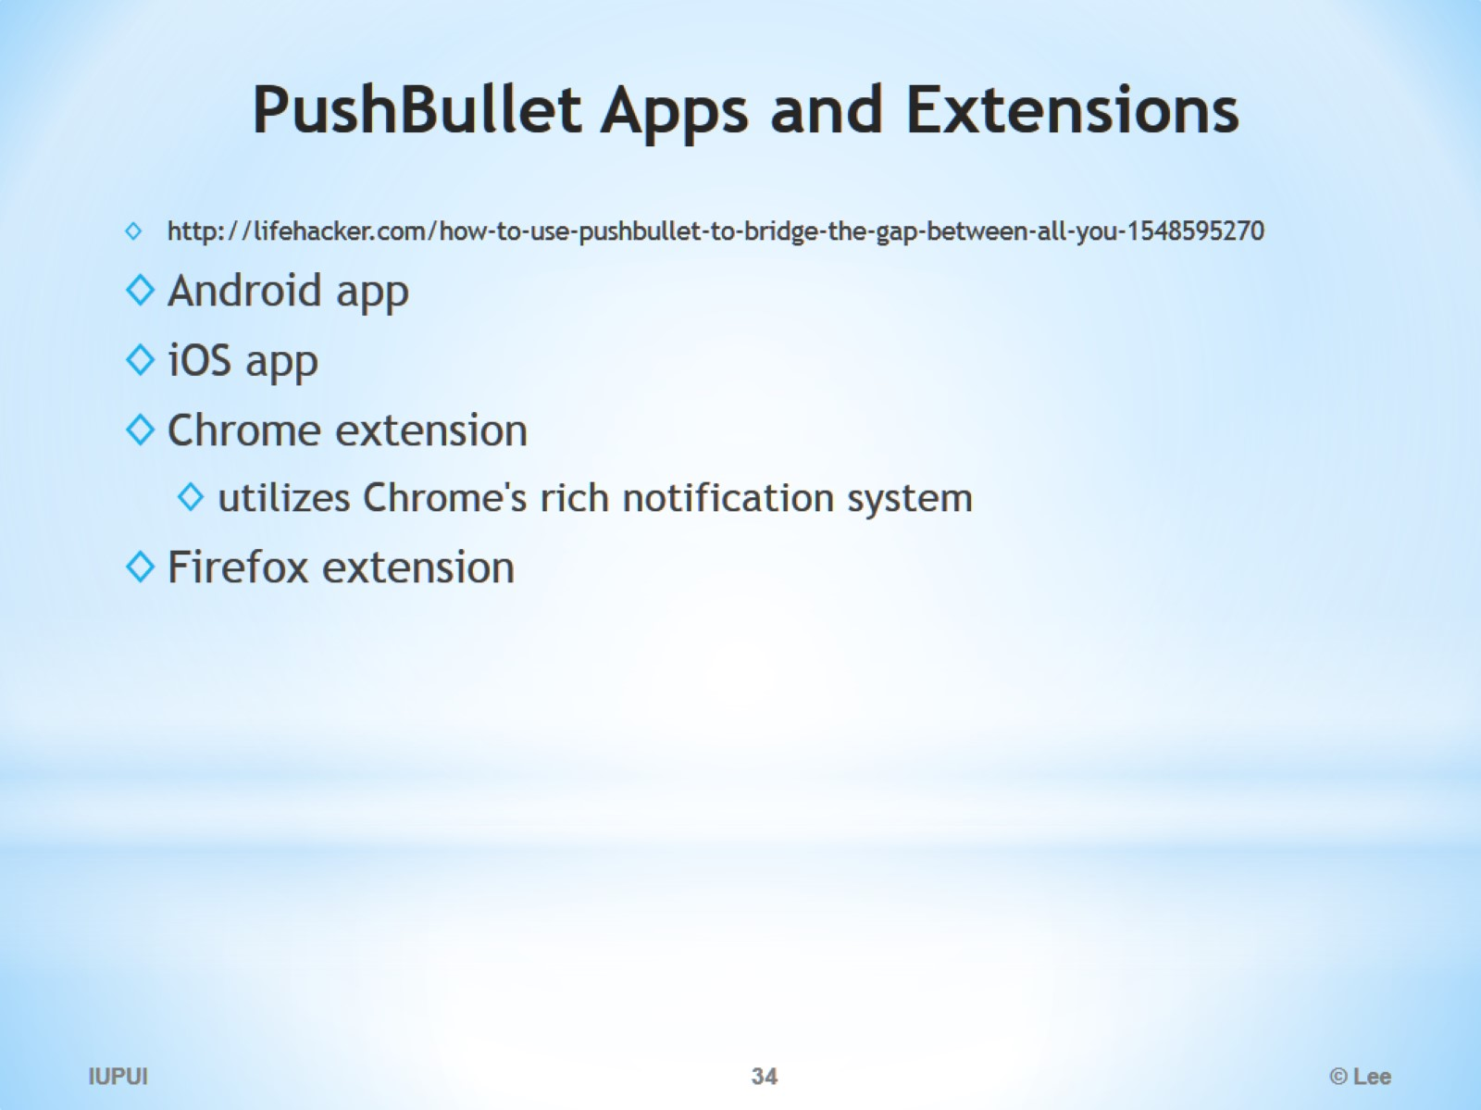
PushBullet Apps and Extensions

Slide 35
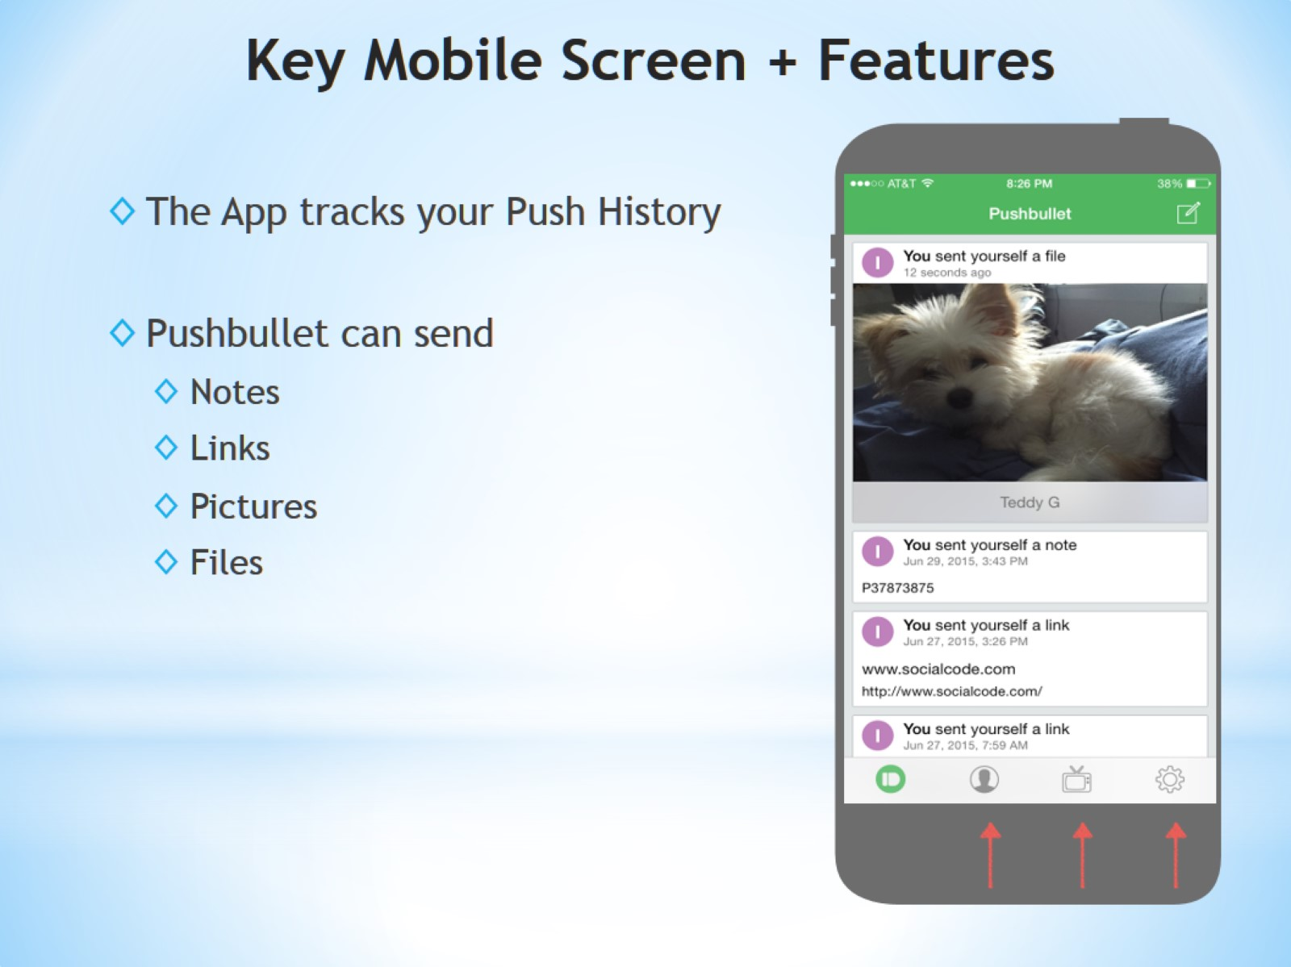
Key Mobile Screen + Features

Slide 36
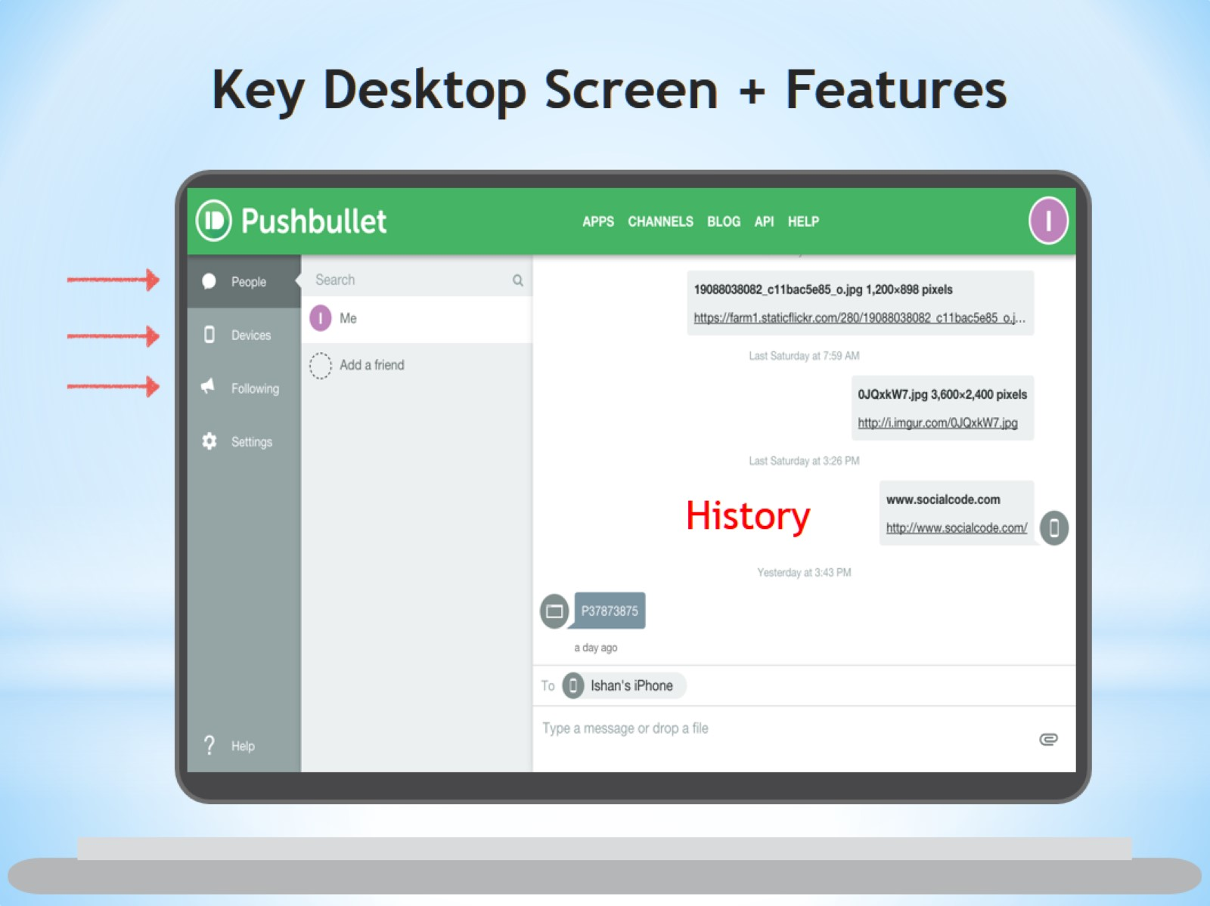
Key Desktop Screen + Features

Slide 37
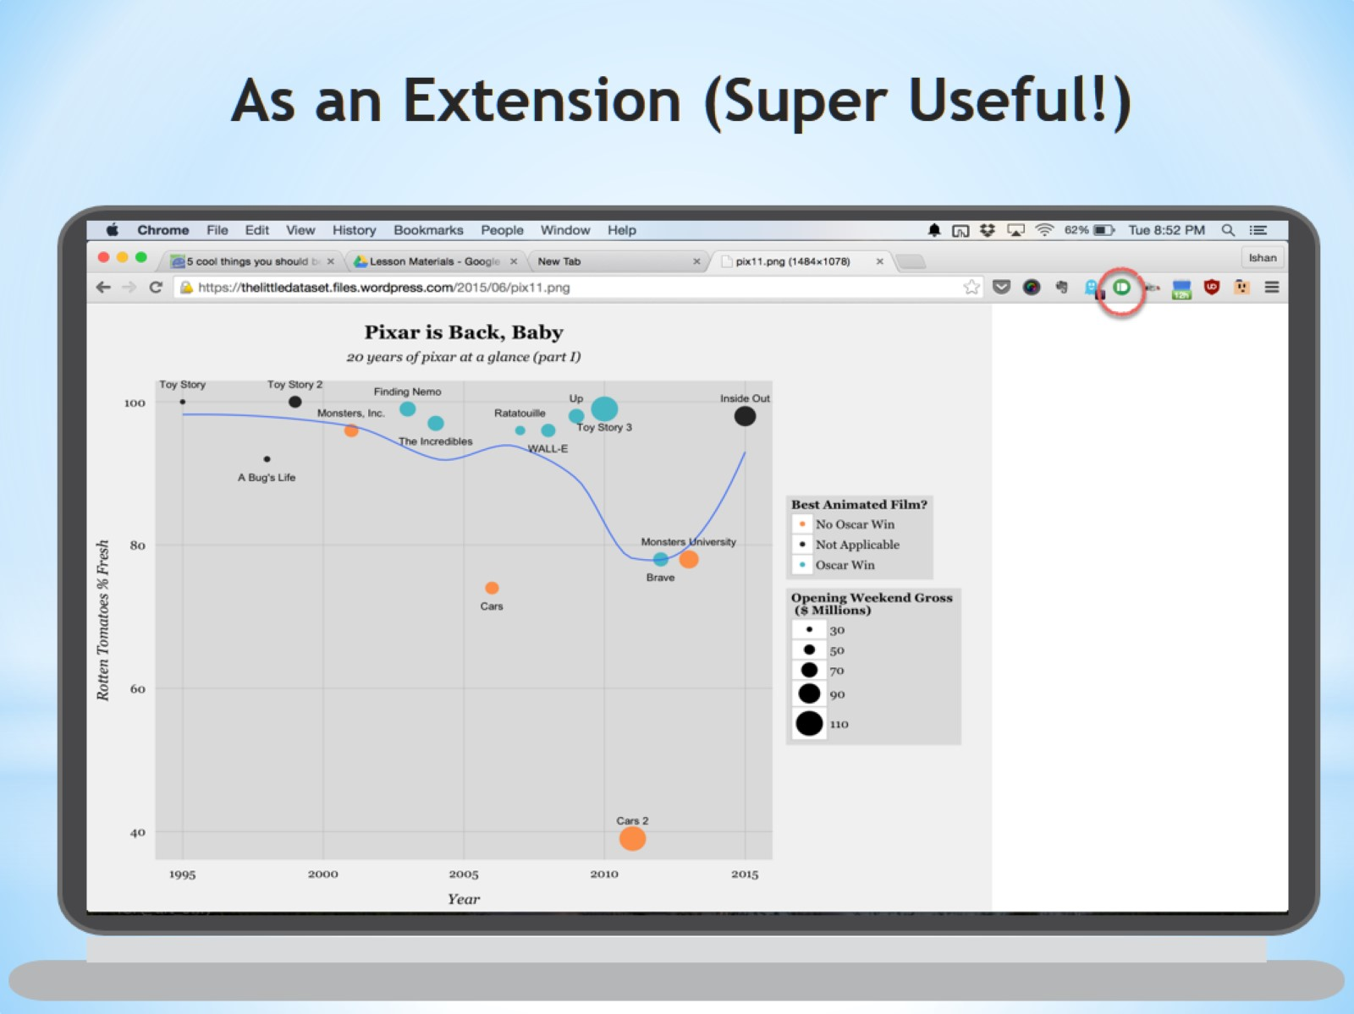
As an Extension (Super Useful!)

Slide 38
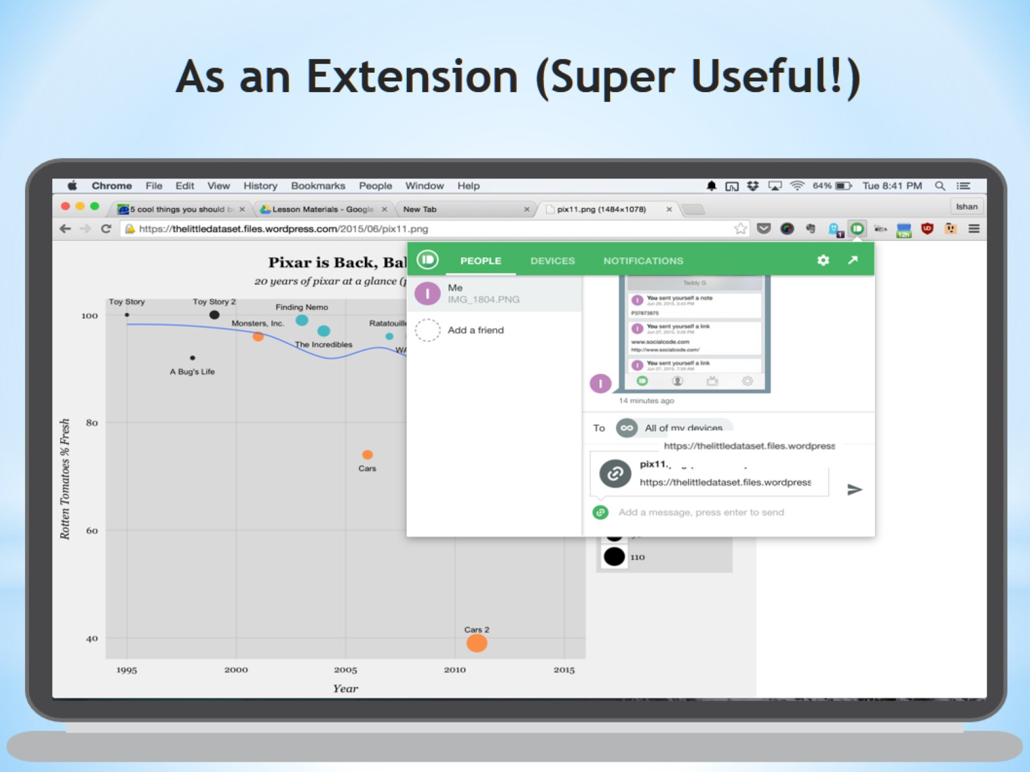
As an Extension (Super Useful!)

Slide 39
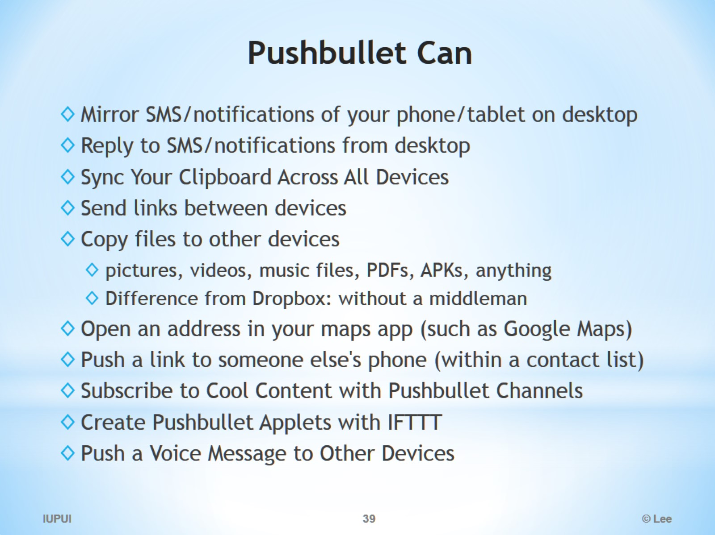
Pushbullet Can

Slide 40
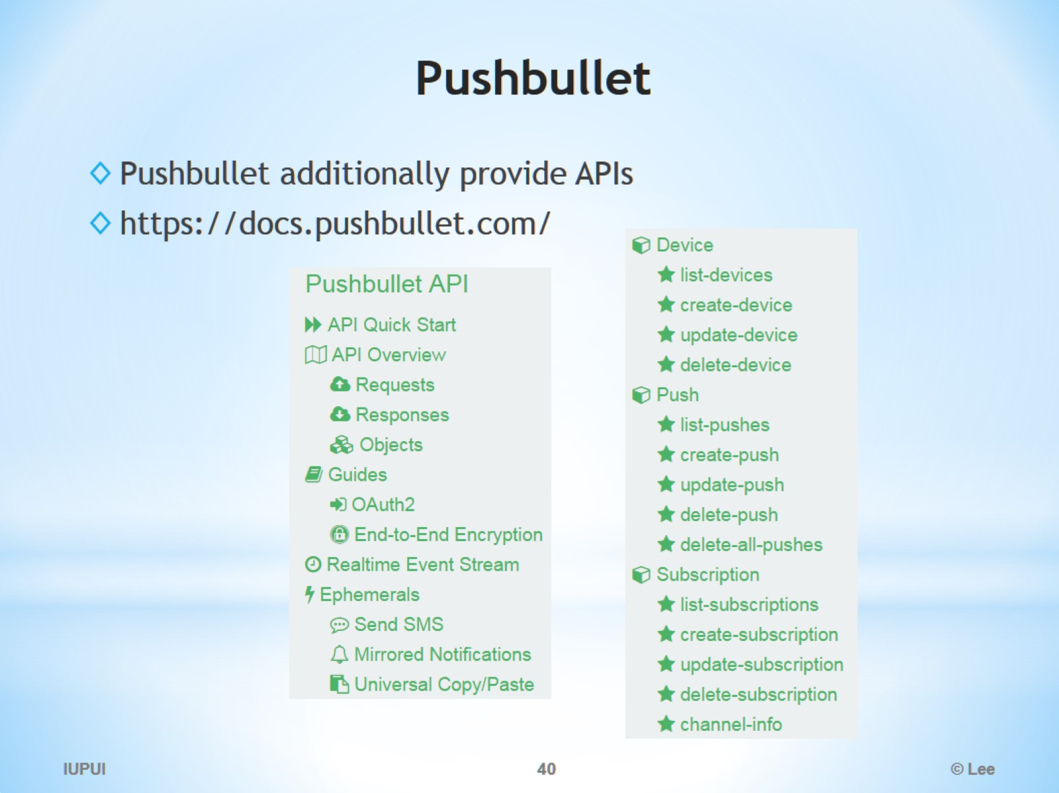
Pushbullet

Slide 41
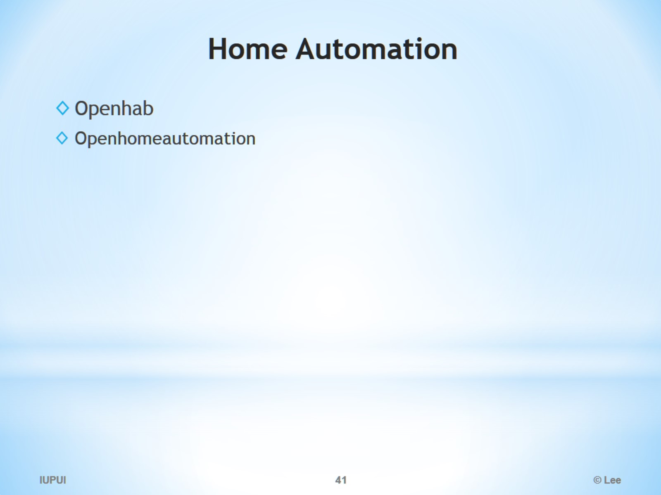
Home Automation

Slide 42
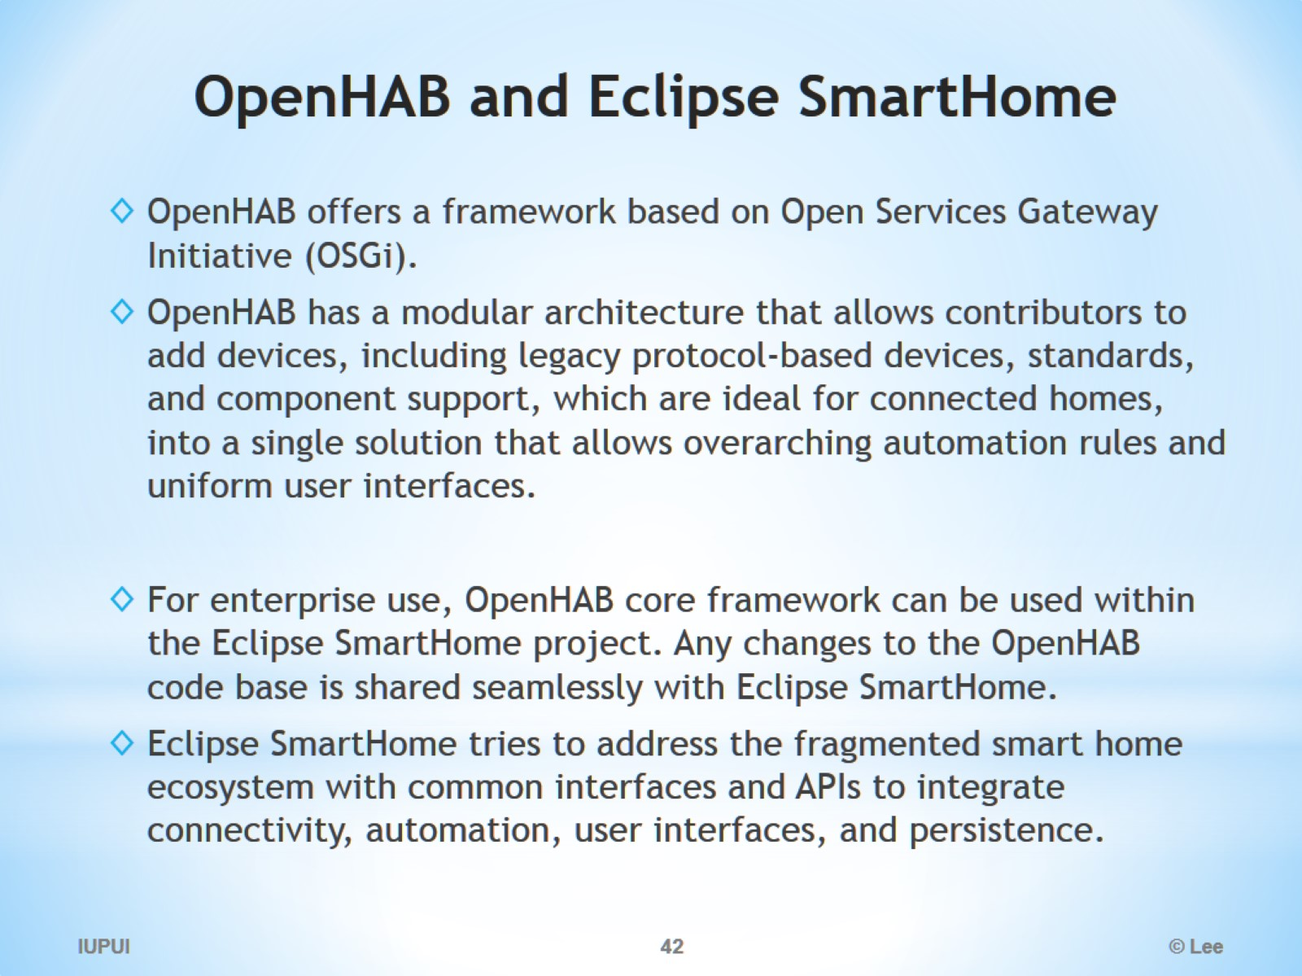
OpenHAB and Eclipse SmartHome

Slide 43
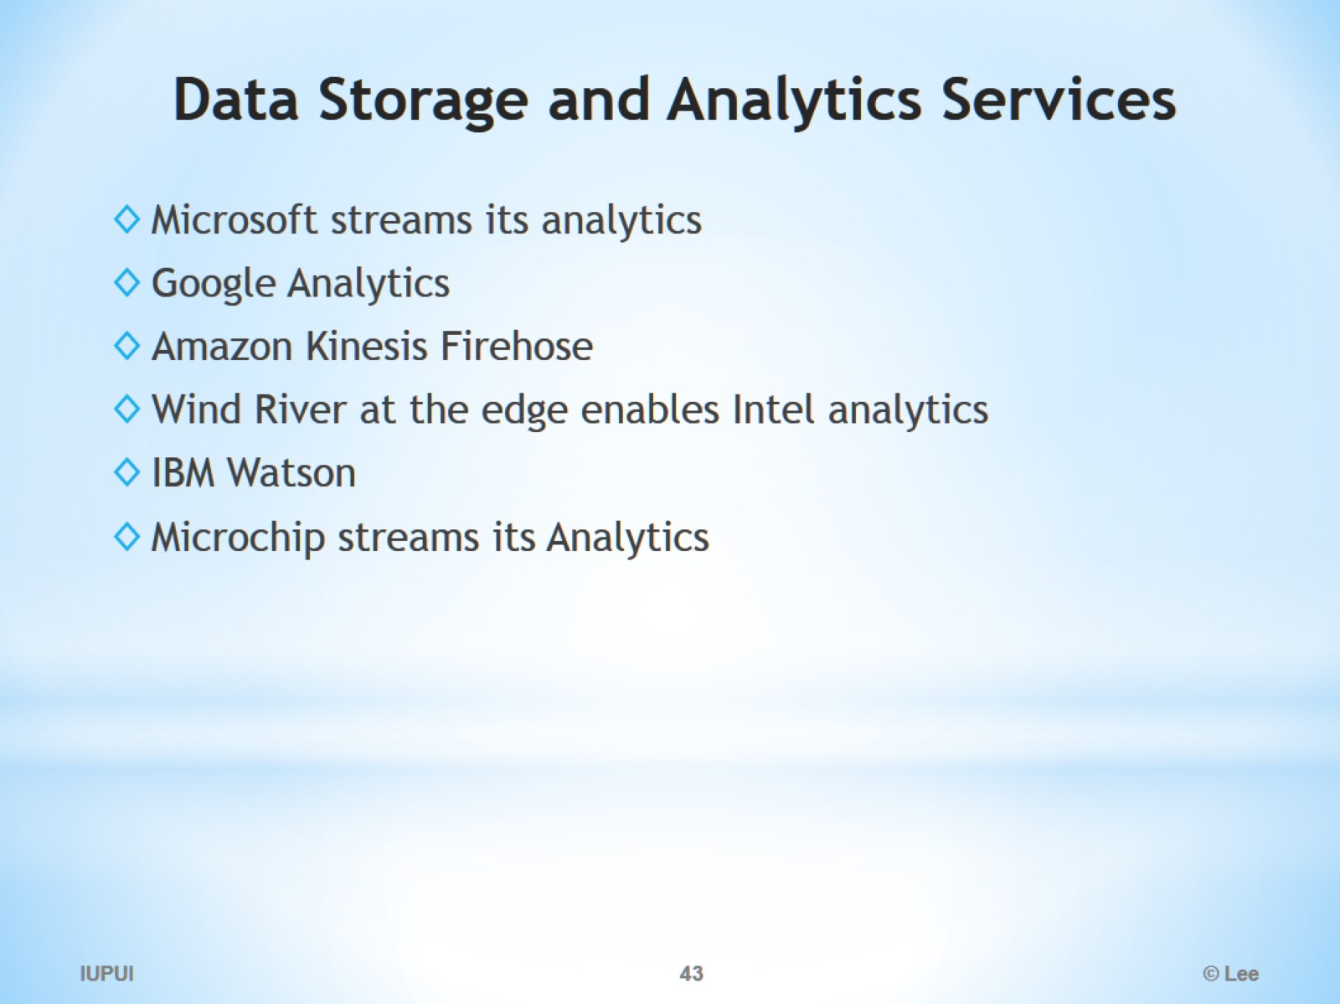
Data Storage and Analytics Services

Slide 44
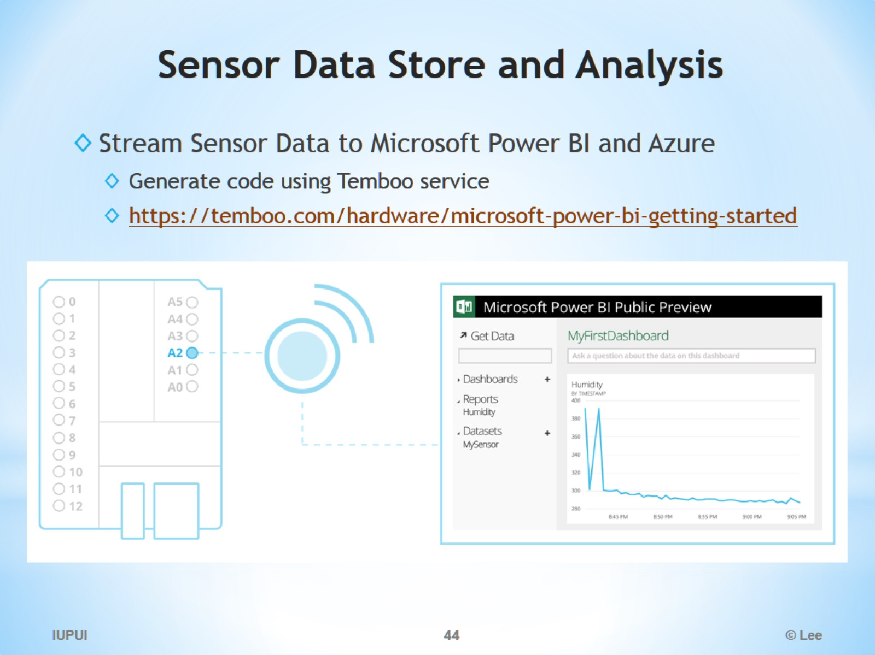
Sensor Data Store and Analysis

Slide 45
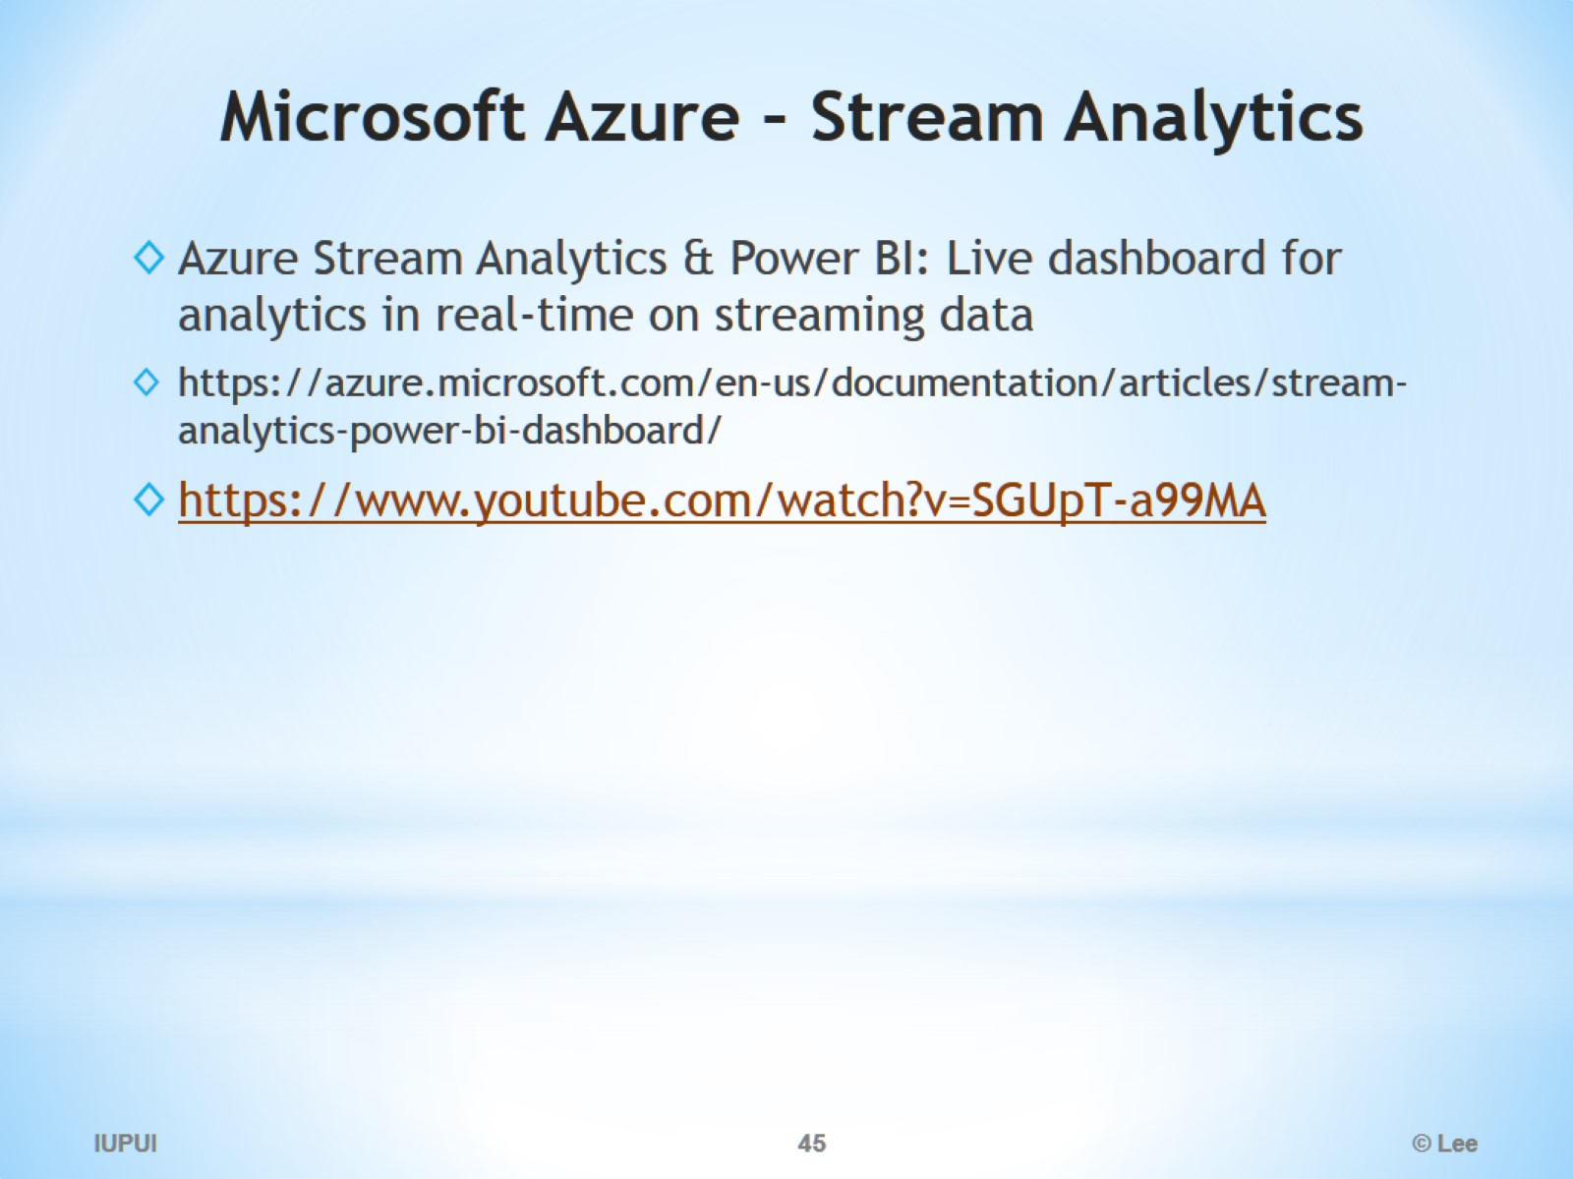
Microsoft Azure – Stream Analytics

Slide 46
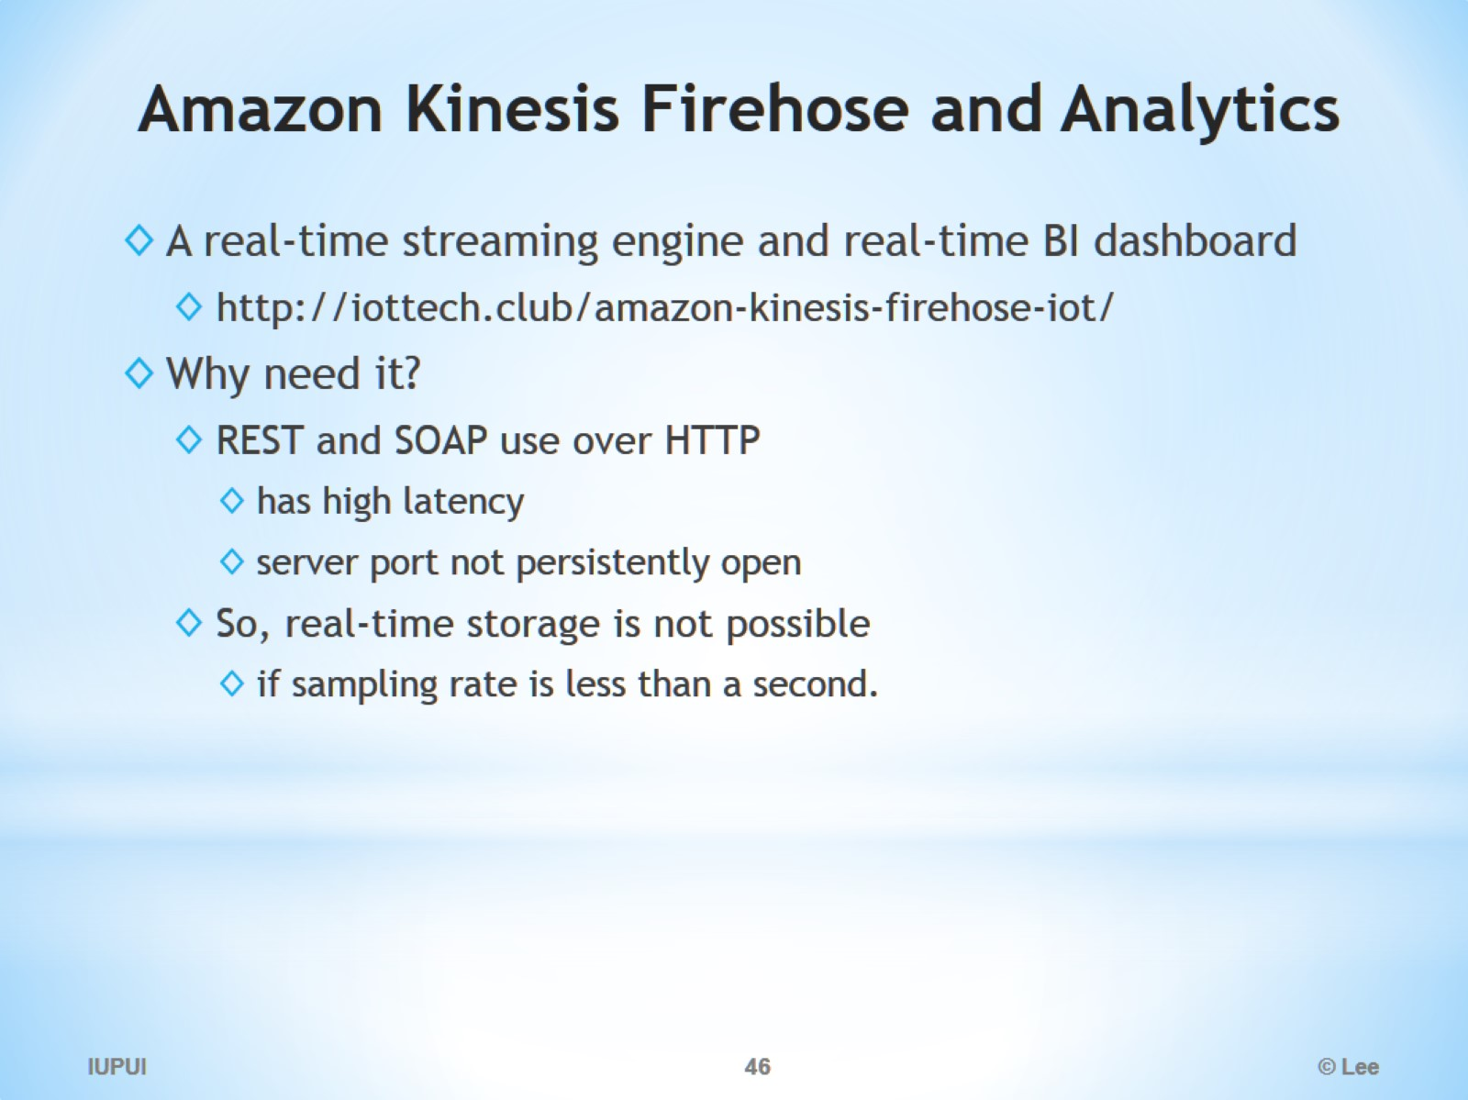
Amazon Kinesis Firehose and Analytics

Slide 47
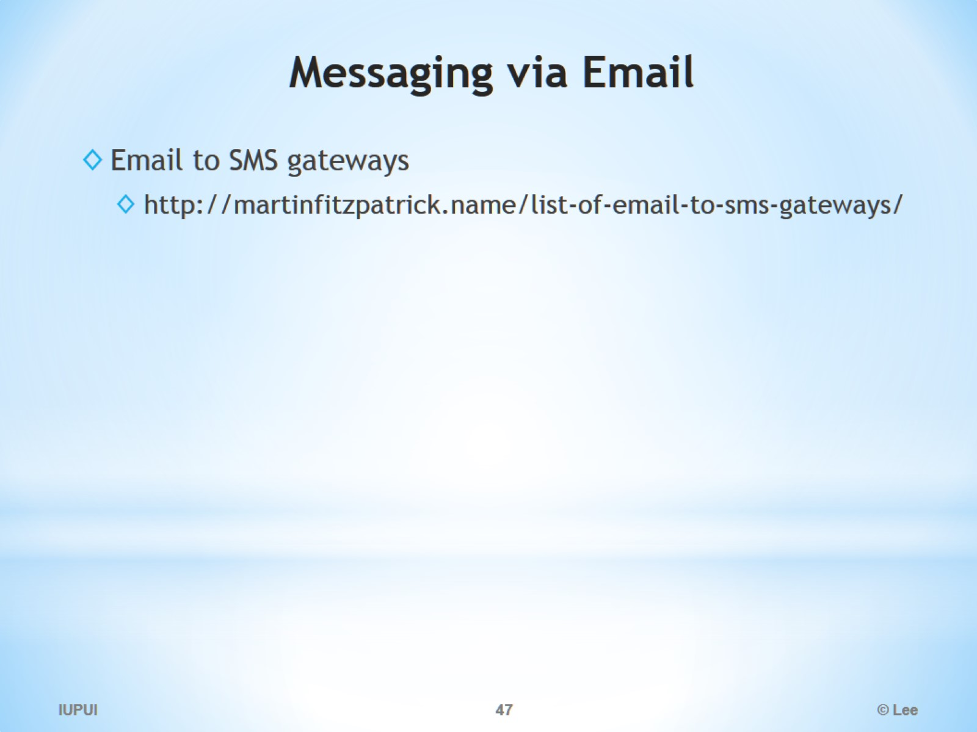
Messaging via Email

Slide 48
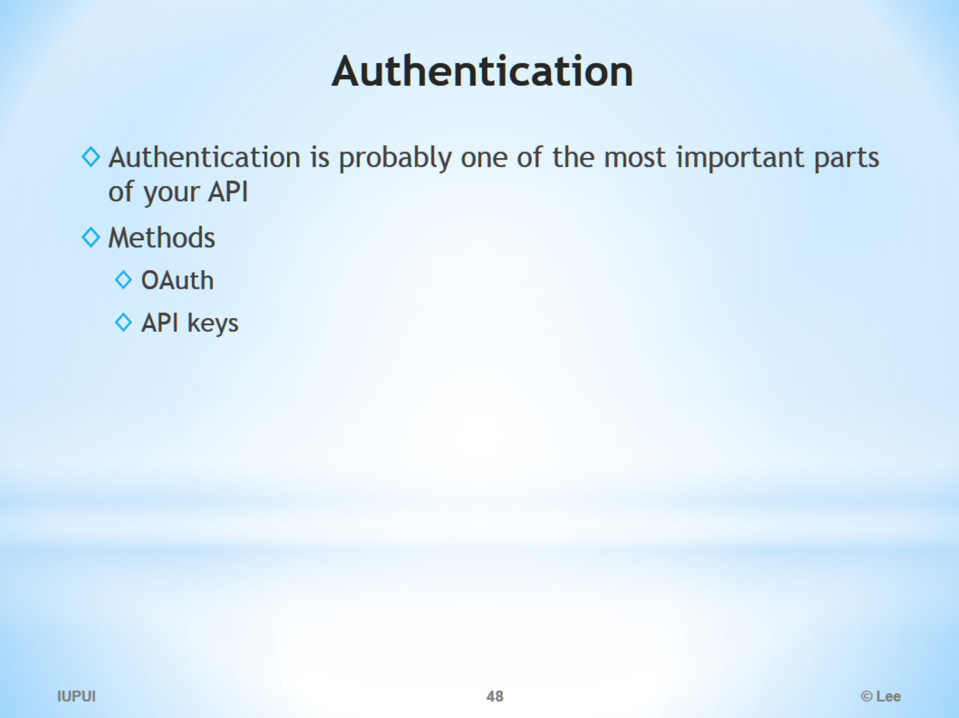
Authentication

Slide 49
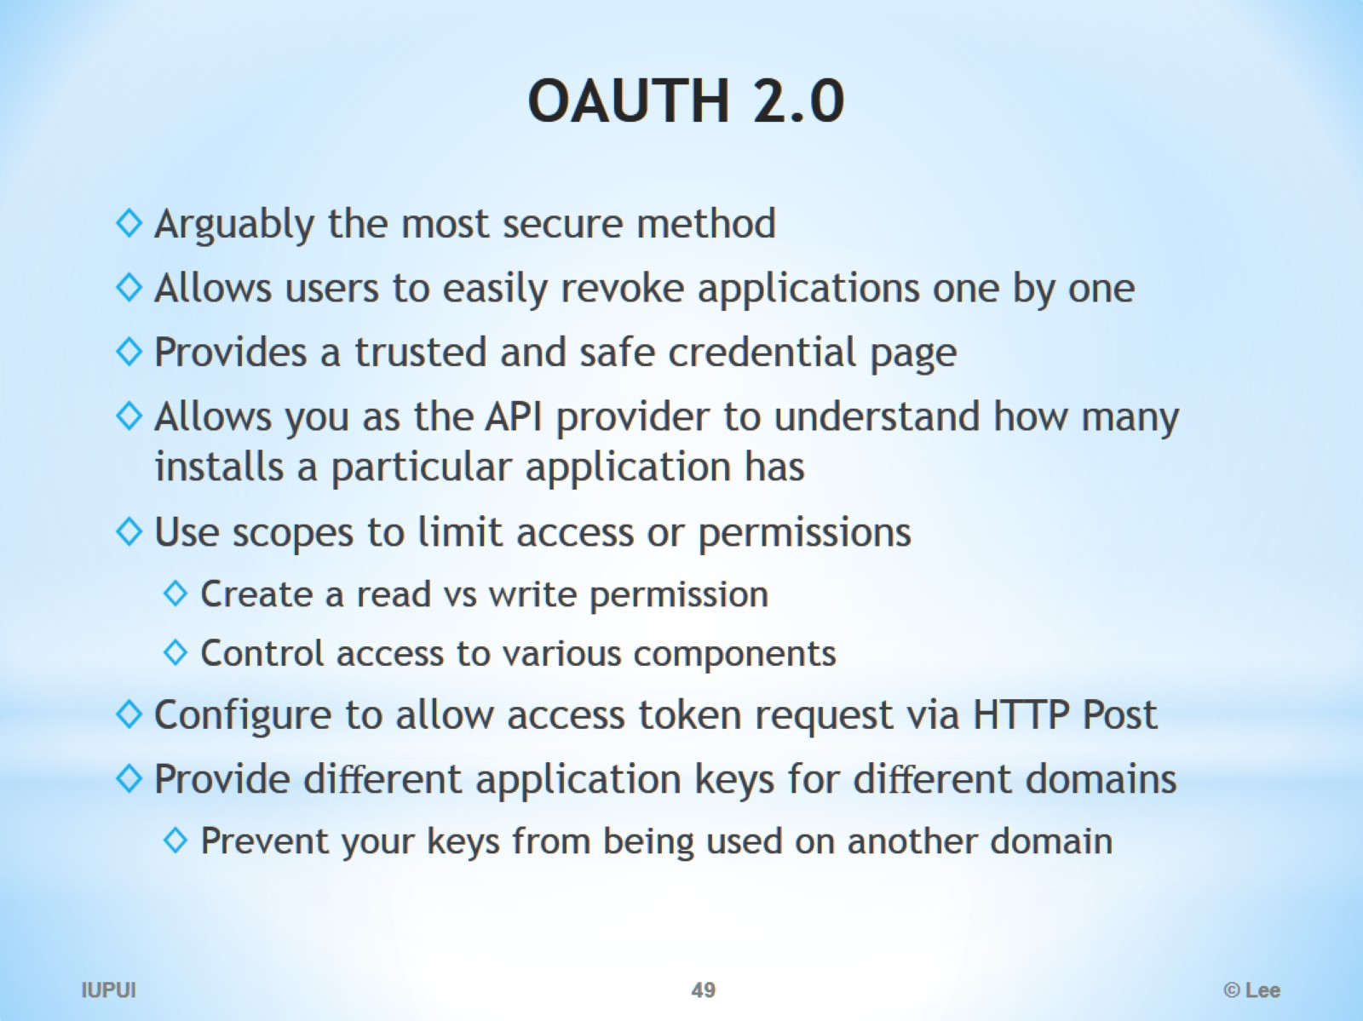
OAUTH 2.0

Slide 50
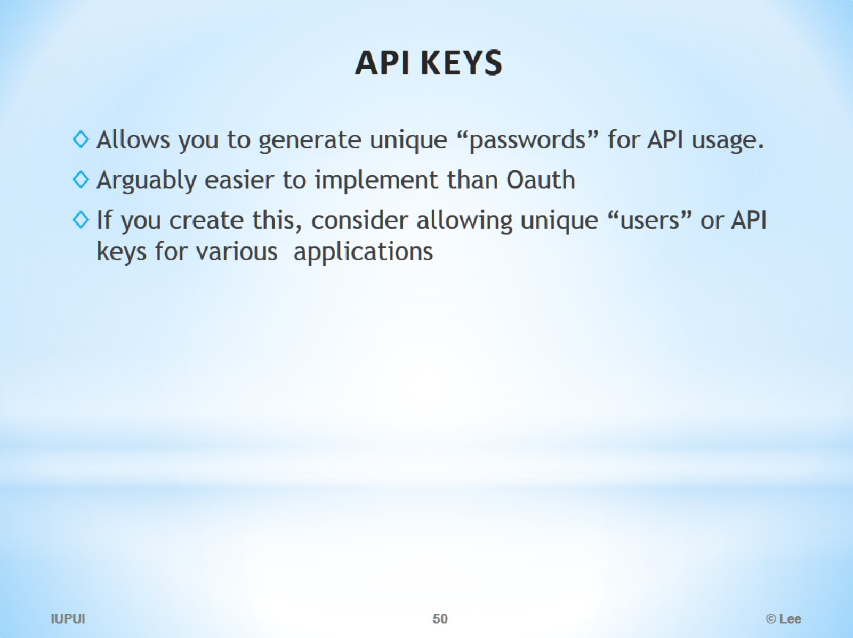
API KEYS

Slide 51
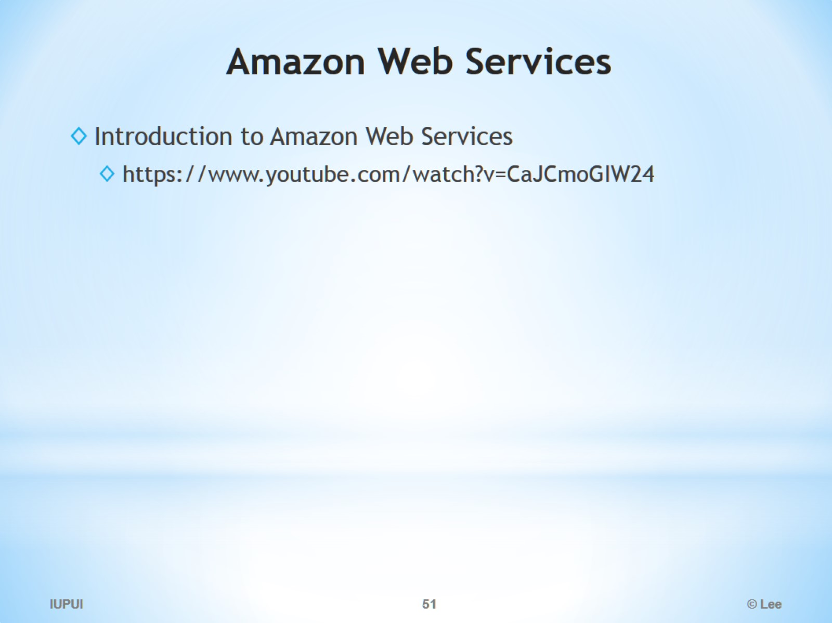
Amazon Web Services

Slide 52
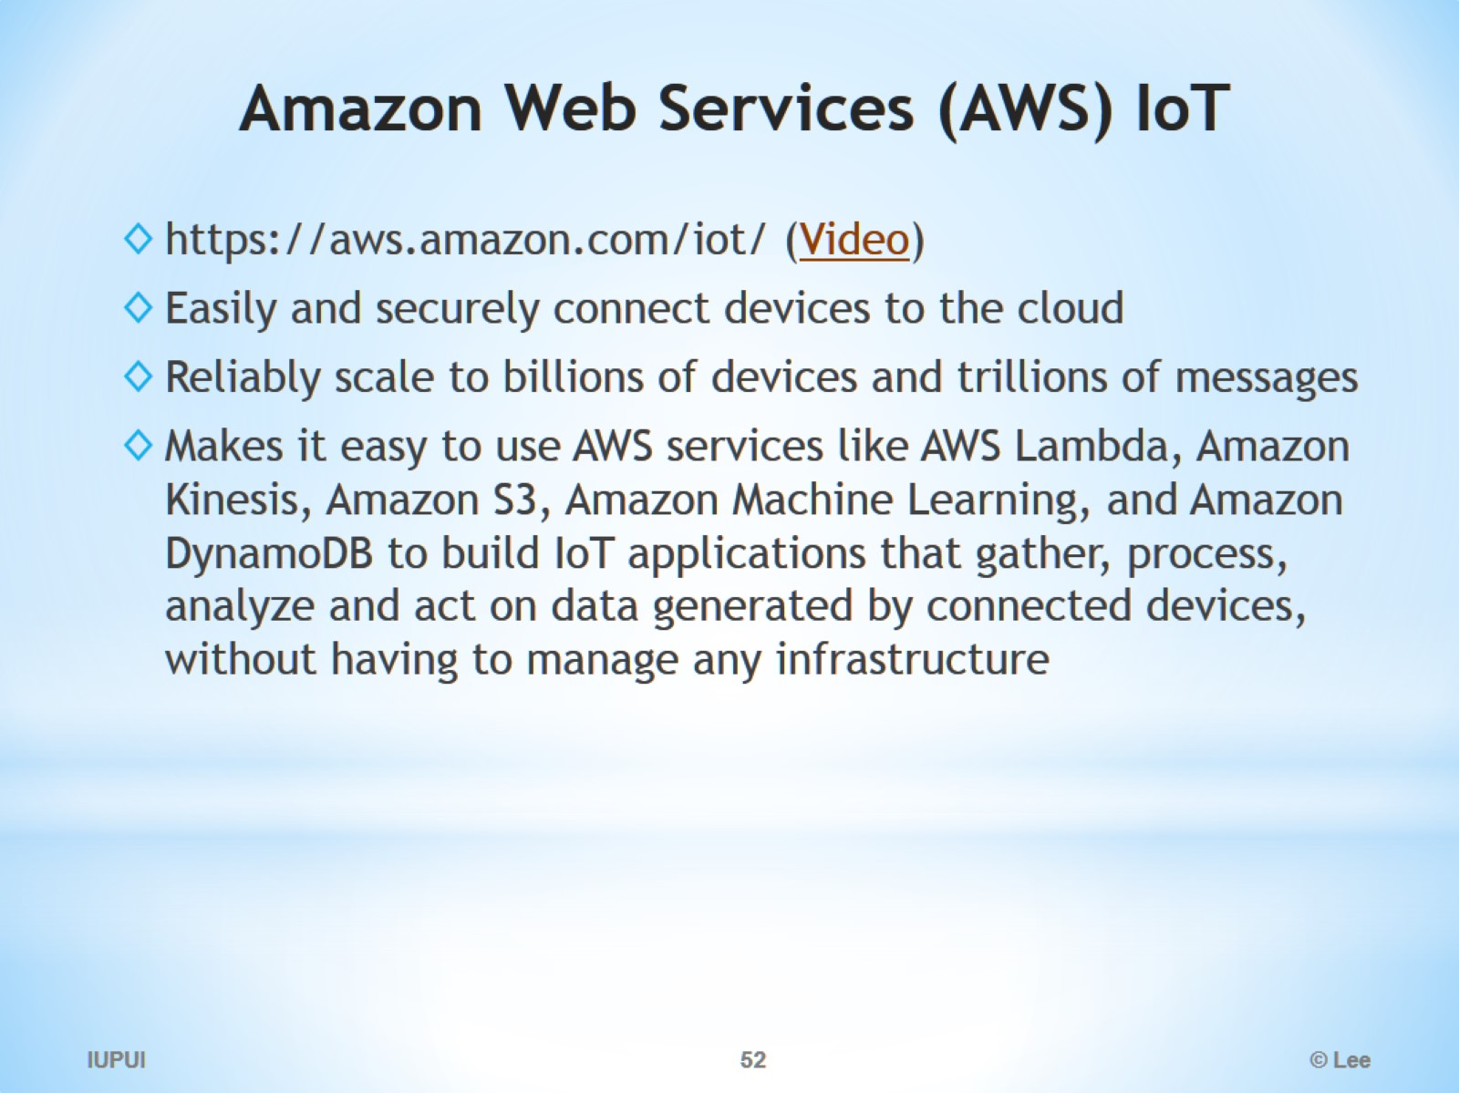
Amazon Web Services (AWS) IoT

Slide 53

AWS IoT

Slide 54

AWS IoT Connected devices + Cloud applications

Slide 55

AWS IoT with AWS S3, DynamoDB, Machine Learning and etc.

Slide 56

Kalay Platform

Slide 57

KALAY P2P / Relay Server

Slide 58

Discovering devices, notifications and live streaming

Slide 59

Partners and Ecosystem

